Slide 1
The Bethany Project Tanzania
1-15 March 2024
Notes:
LK

Slide 2
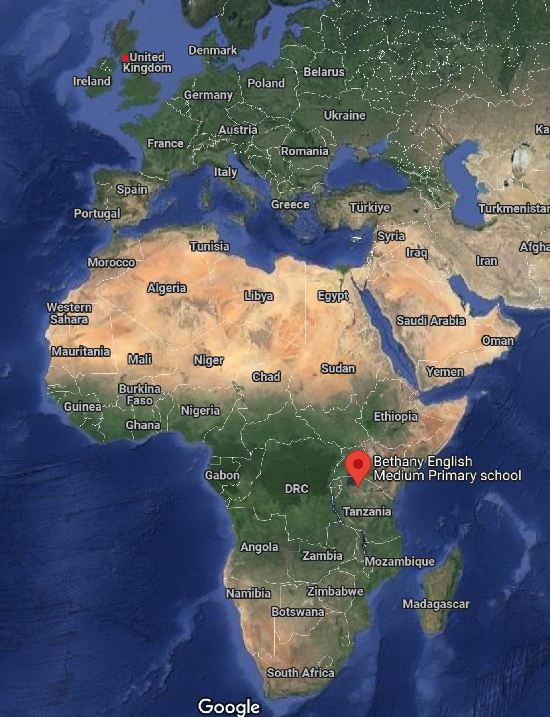
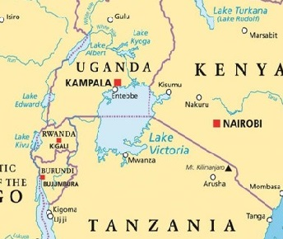
Where are we?
Where is Bethany?
Bethany
Notes:
LK
On shores of Lake Victoria 26, 564 square miles
Lake shared by Tanzania, Uganda and Kenya

Slide 3
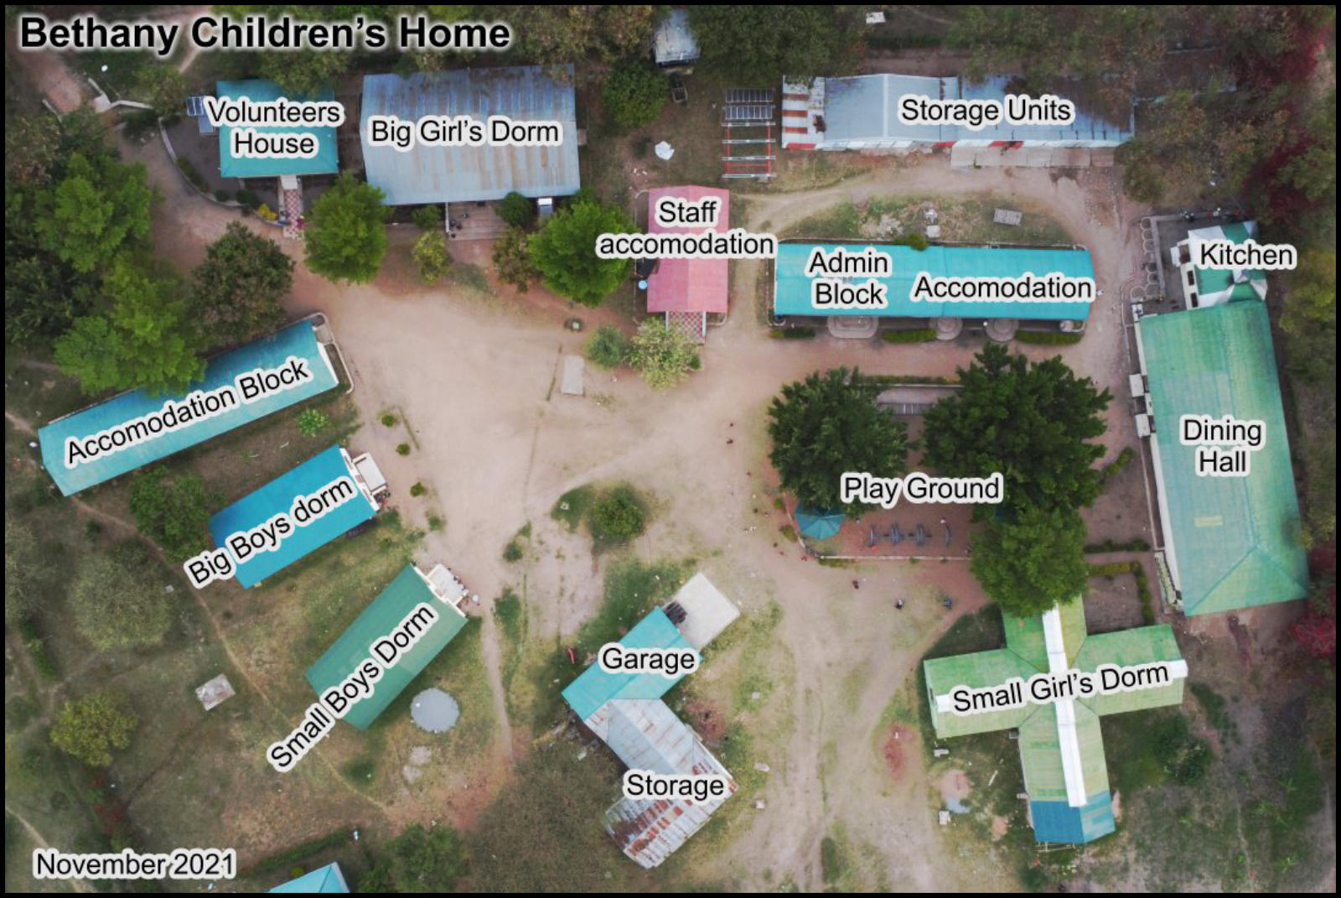
The Bethany Project, founded in 1991, cares for about 150 orphaned children between 1 and 20 years old
Aims and objectives:
Education
Love
Commitment
Compassion
Notes:
Bethany is a Christian charity/project that helps the most underprivileged, deprived and vulnerable members of society, especially orphaned children, providing education where possible.
Work carried out with love, commitment and compassion.

Slide 4
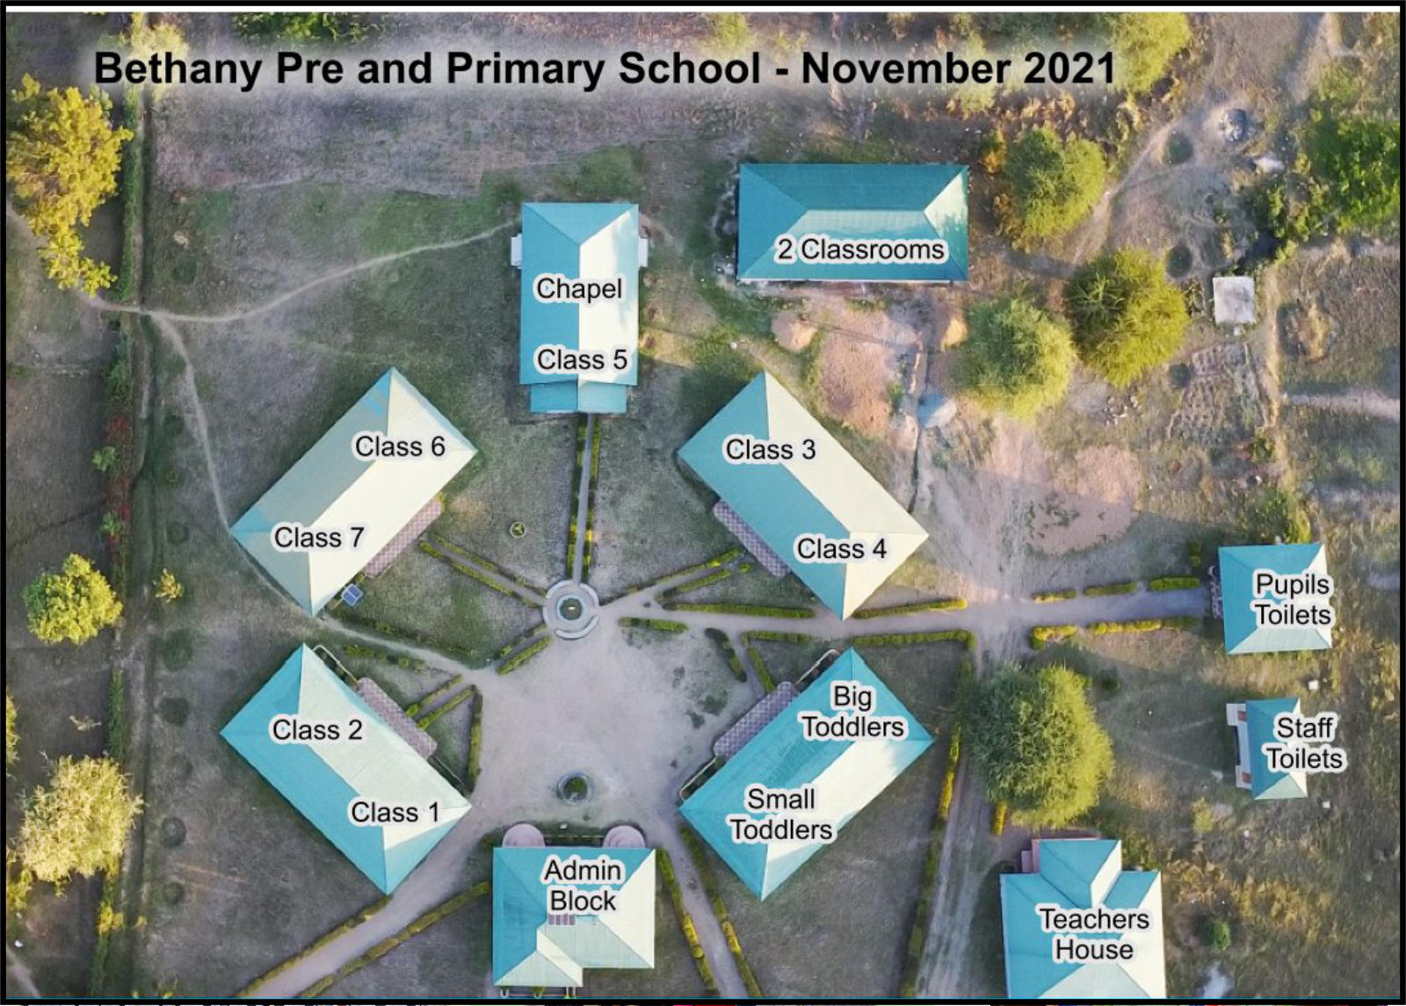
Bethany School
340+ pupils from Bethany and surrounding villages
Lessons taught exclusively in English
18-20 teachers
One Headmistress
School is FREE
Funded by donations.
Notes:
Taught exclusively in English because secondary school is only taught in English. If a child isn’t fluent in English, they can’t attend or further their education. They remain trapped in poverty.
Rural schools are taught in Swahili, Bethany is one of the few primary schools in Tanzania that teaches all the lessons in English.
School open to local children as long as they have a uniform (usually provided by the school).
No one is turned away.

Slide 5
Why did we go to Bethany?
Debbie M was challenged after going to a presentation about Bethany by the Headmistress Emma and five children from the orphanage and school.
Debbie was impressed by Bethany’s practical approach to breaking the cycle of poverty, a challenge faced by many Tanzanians, but particularly orphans.
Debbie was inspired by the Christian ethos of the orphanage.
Debbie M said to Debbie B ‘Do you want to go and volunteer in a Christian orphanage in Tanzania?’ She replied, ‘Yes let’s! With lashings of ginger beer!’
So, we did (once we’d jumped through all the safeguarding hoops – which further impressed us).
Notes:
LK
Christian ethos: Love/compassion/commitment.

Slide 6
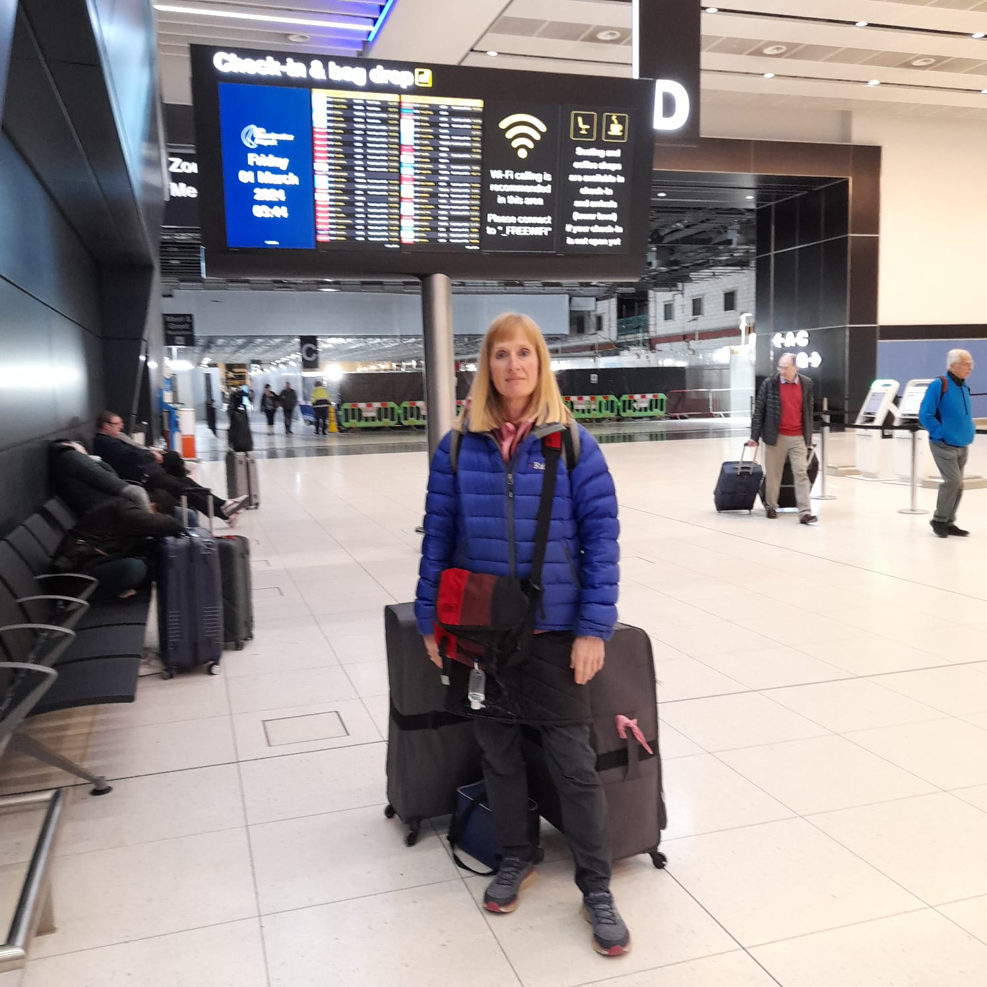
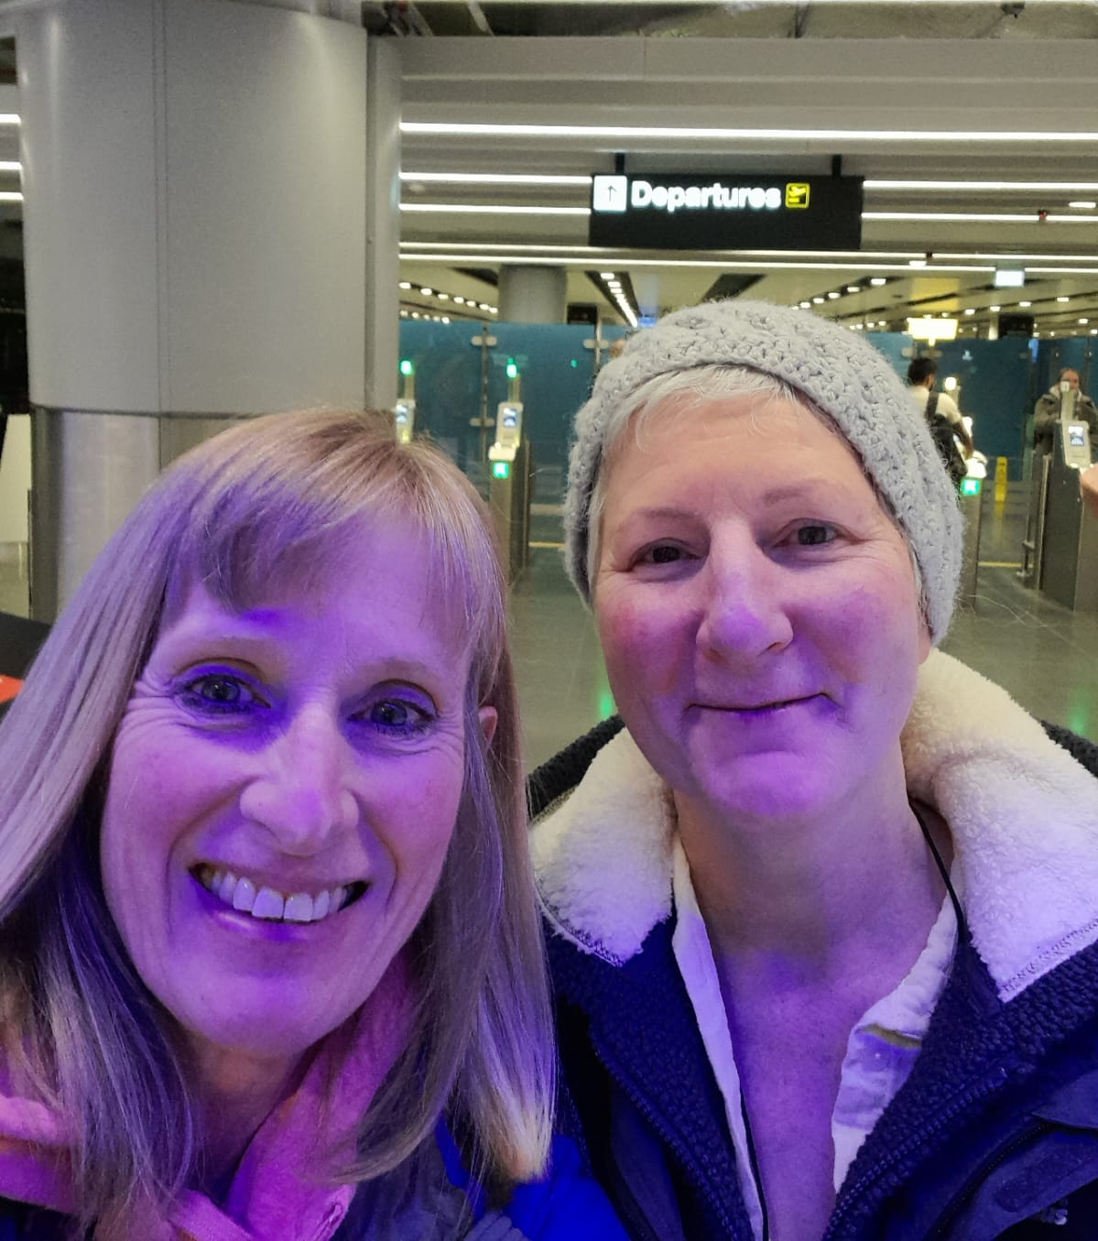
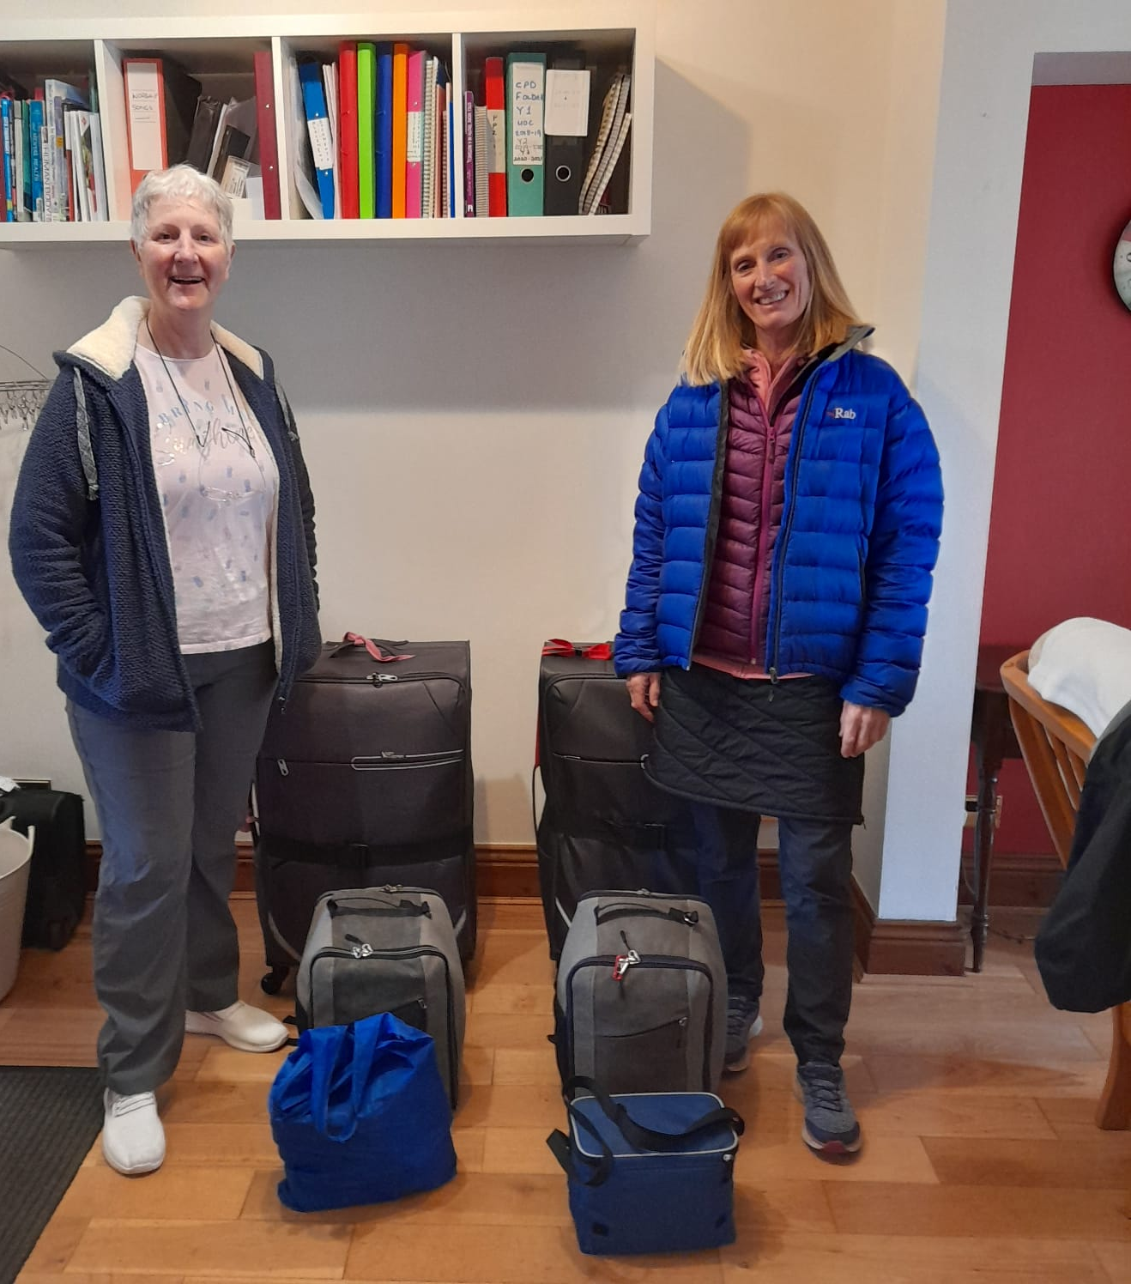
The start of our Journey

Slide 7
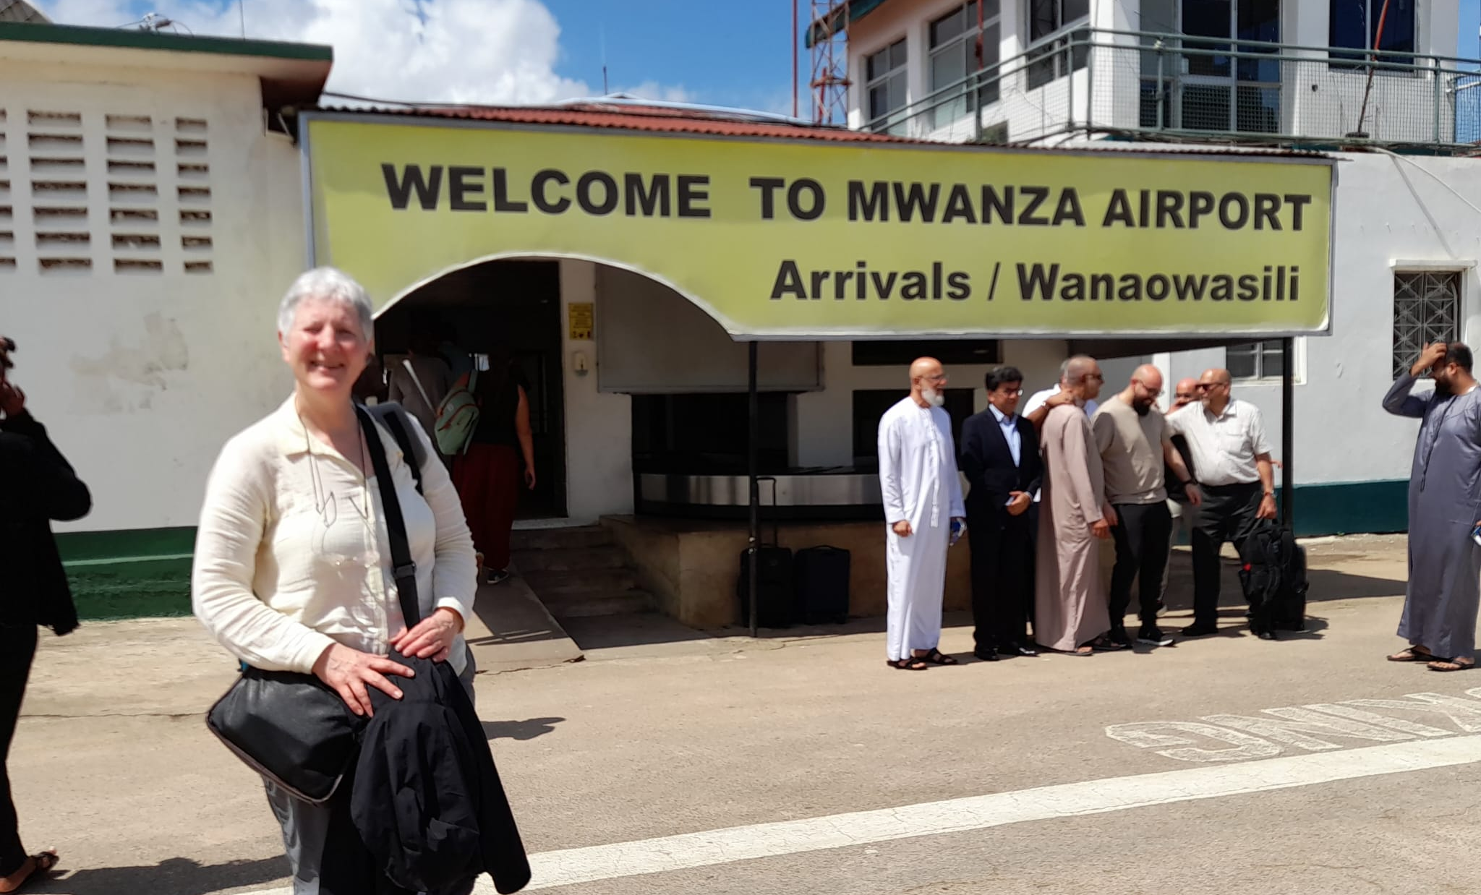
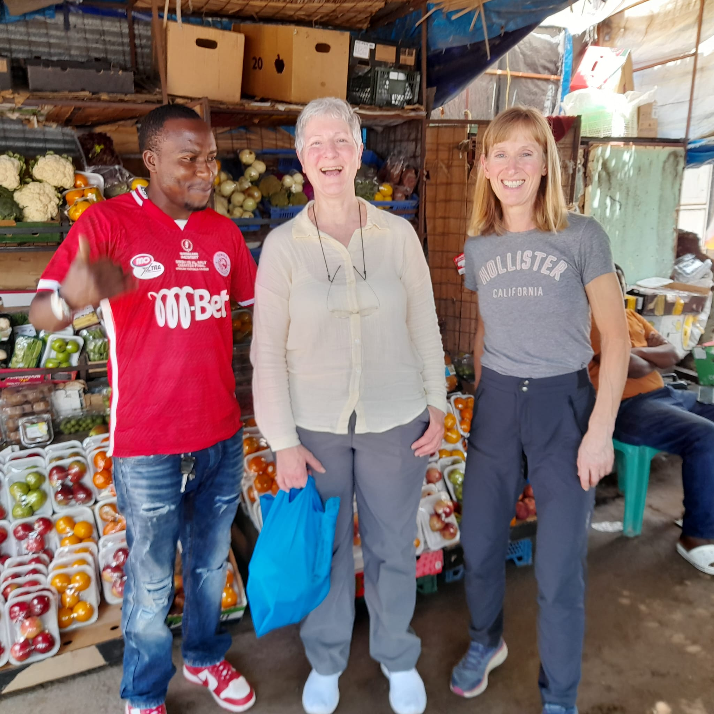
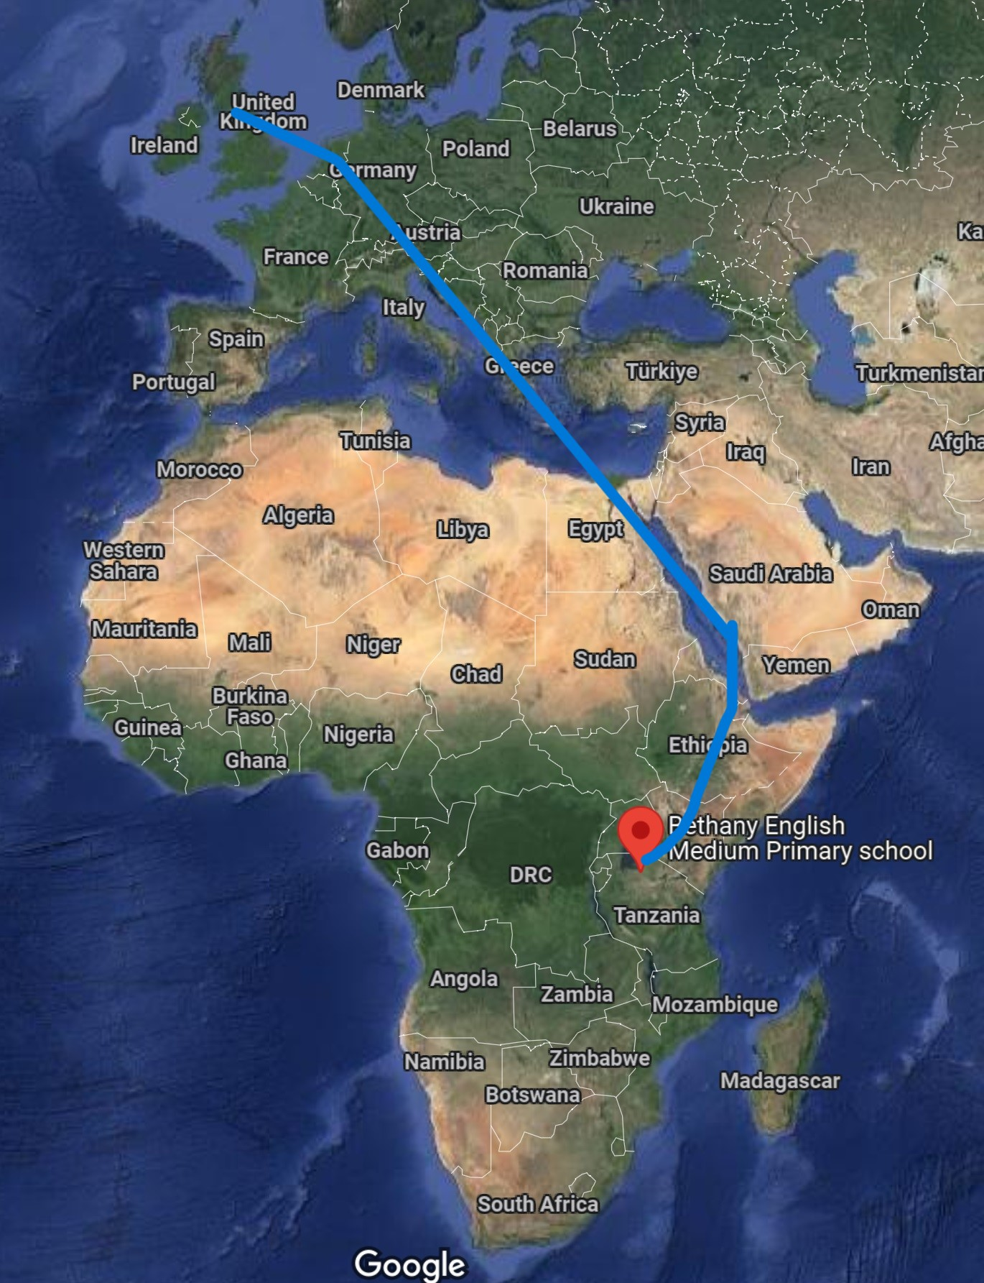
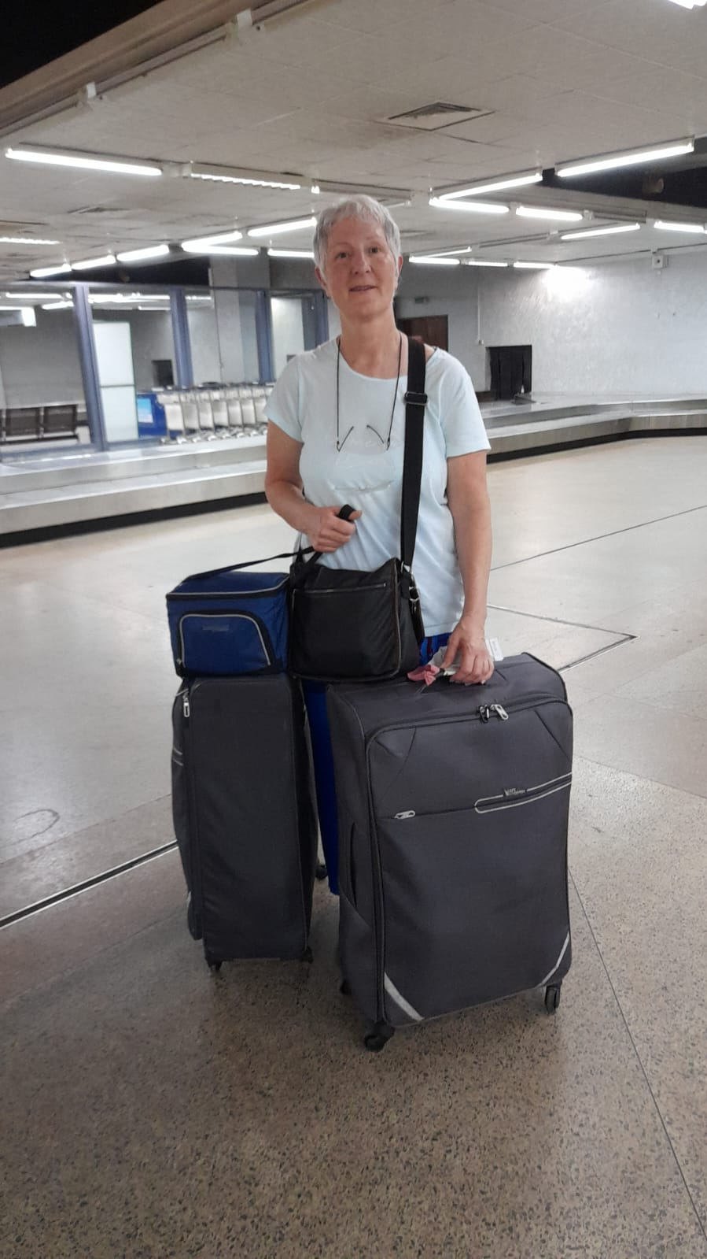
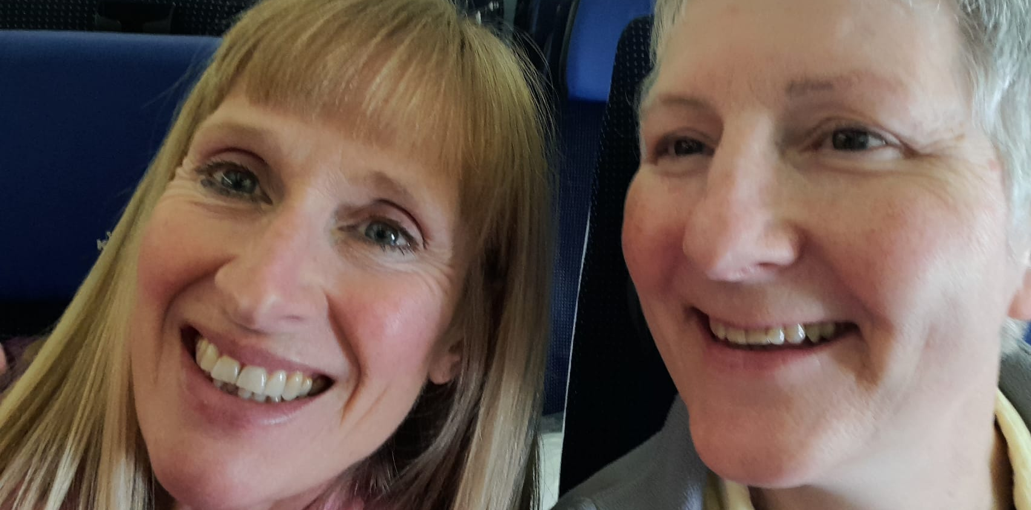
Journey from Hell
47 hours
God’s providence
Notes:
Nairobi airport: big delays, flights cancelled. No seats for us unless we bought more tickets. Debbie B prayed, Debbie M pestered. There was one seat left. Another passenger gave us his ticket. We were the last two on the flight.
Dar Es Salaam: Missed our flight to Mwanza. Next flight fully booked. Debbie B prayed. Debbie M pestered. Two passengers failed to appear, we had to pay (again) but got the last two seats.

Slide 8
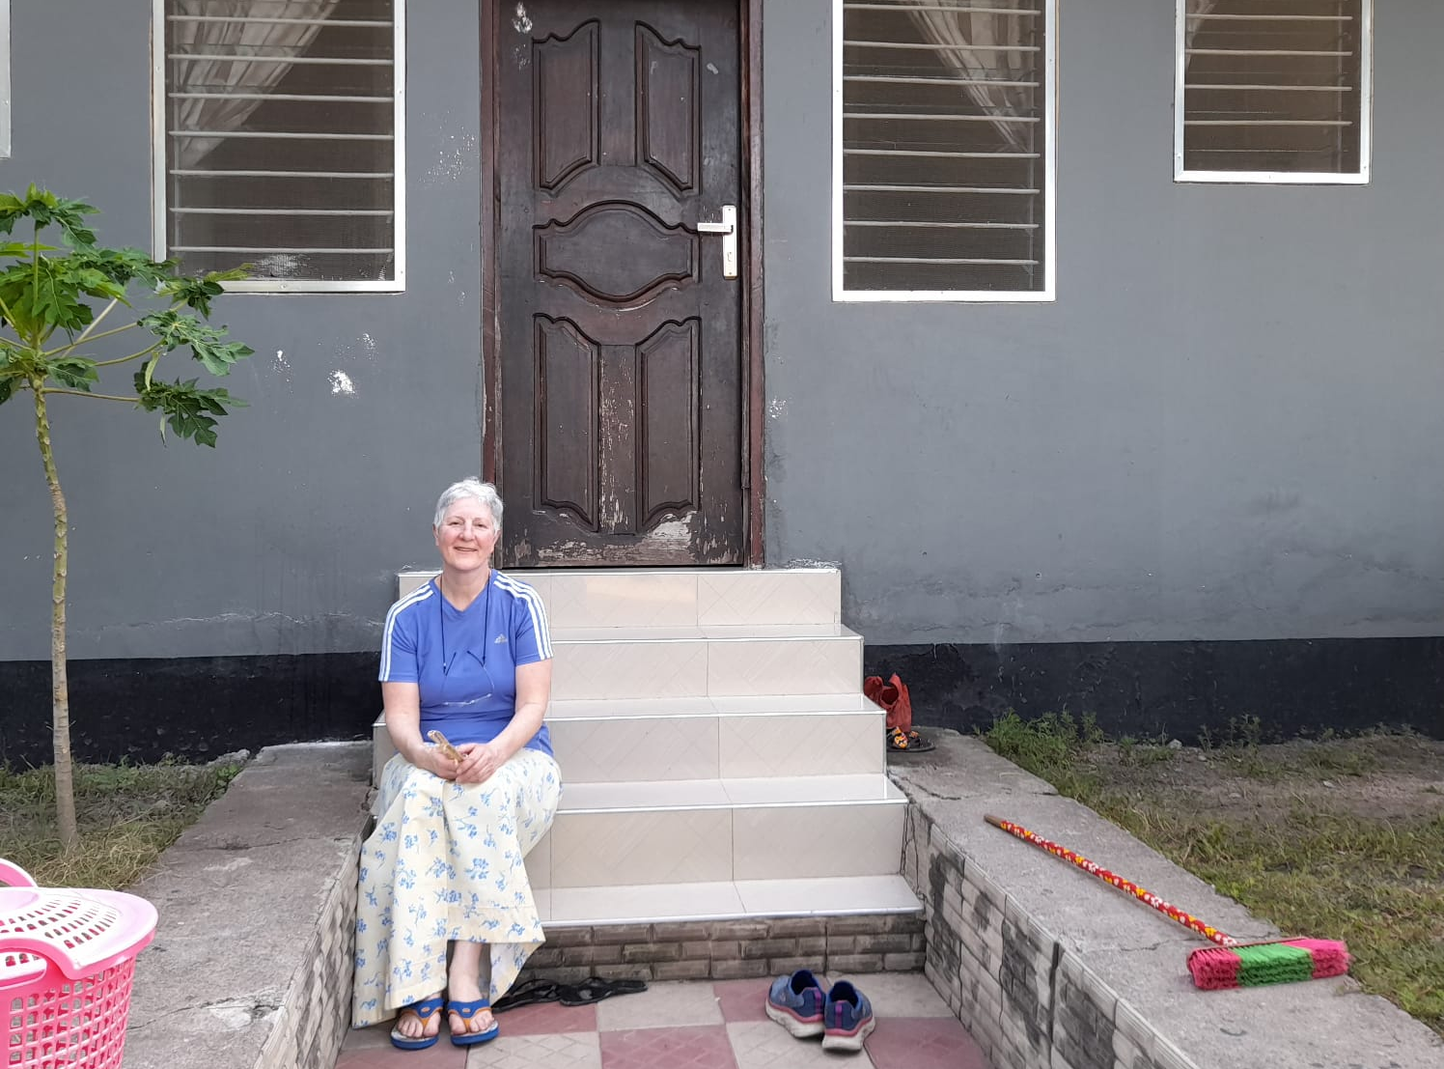
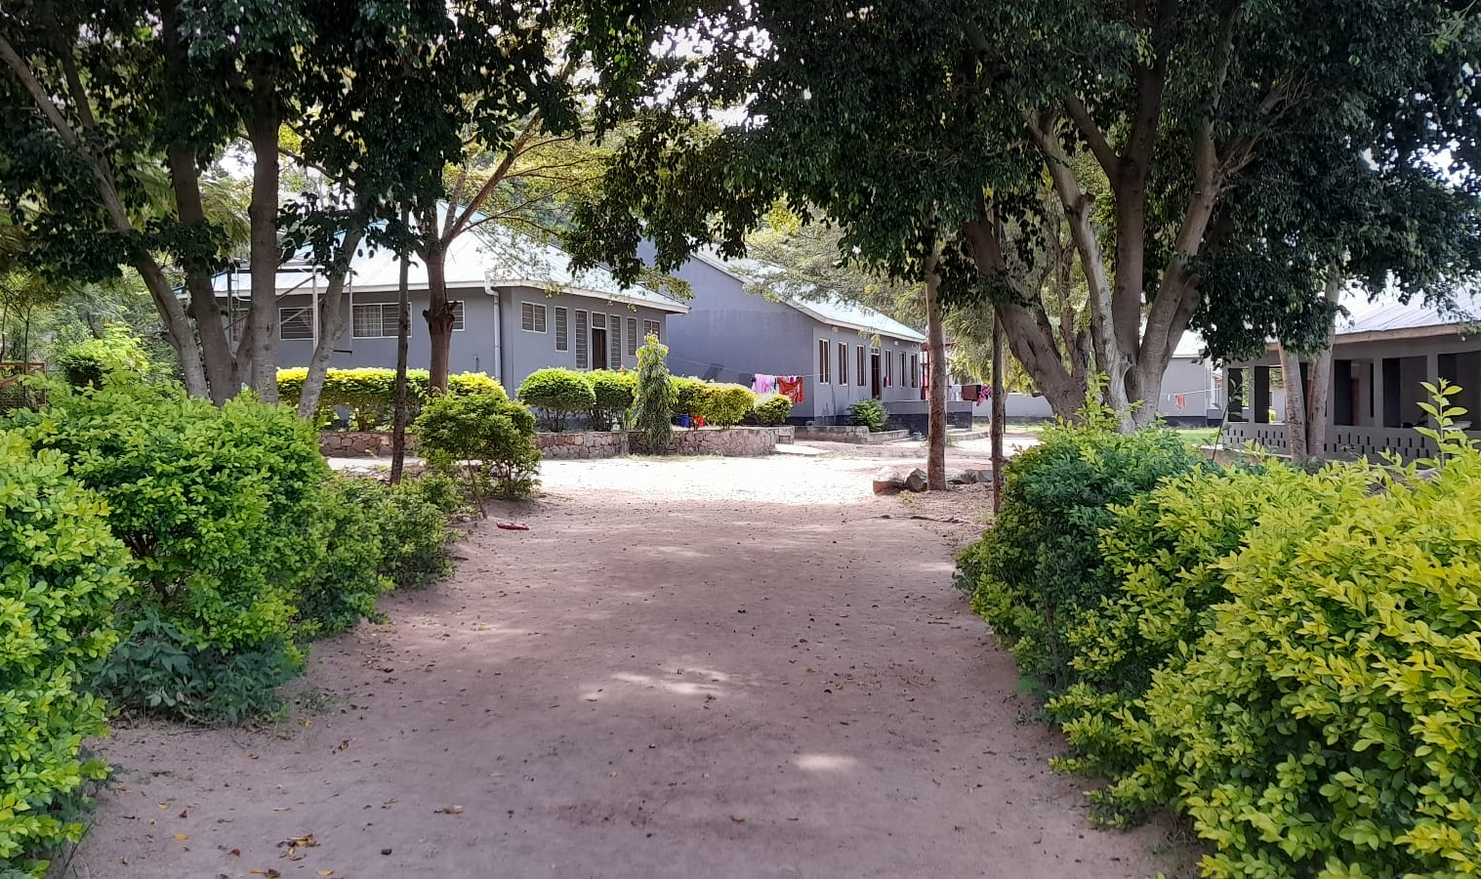
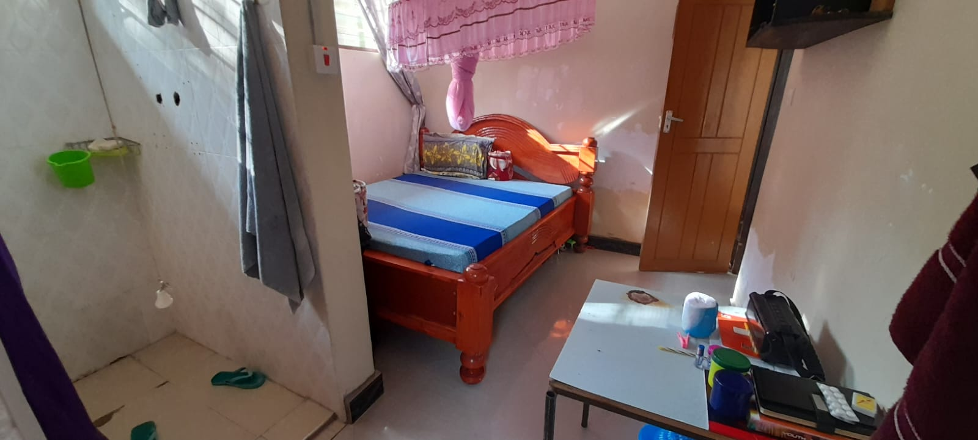
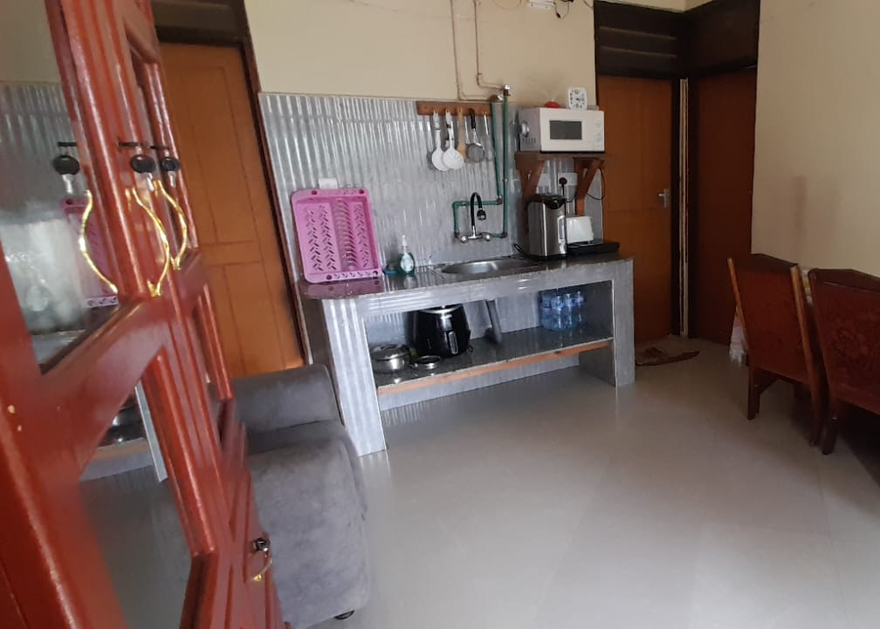
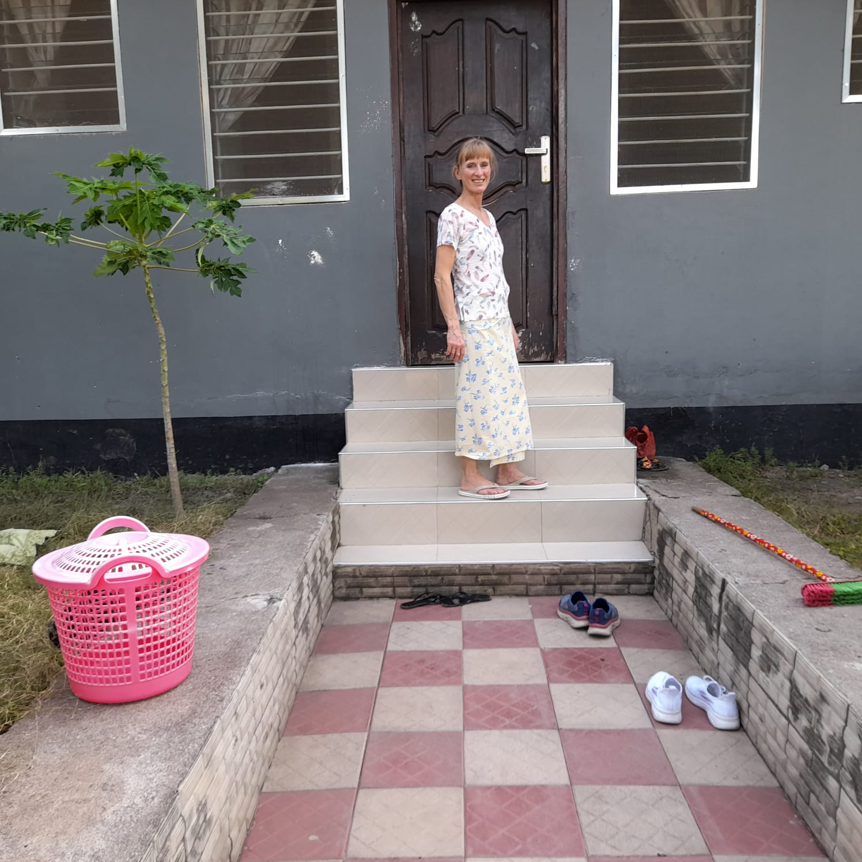
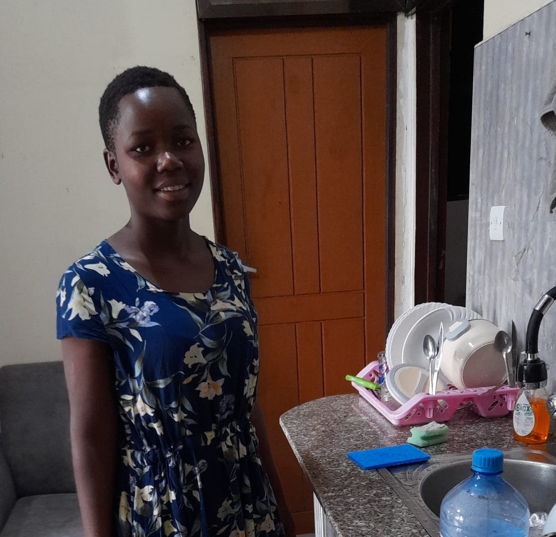
Notes:
Our bungalow.
Teddy (18) in the kitchen area. We did a bible study with her every day – she was so keen.
Showering Tanzanian style when no water pressure..
View of the bungalow.

Slide 9
Nightly Serenade

Slide 10
Notes:
BK
Solar panels and water tank – pumped from Lake Victoria.

Slide 11
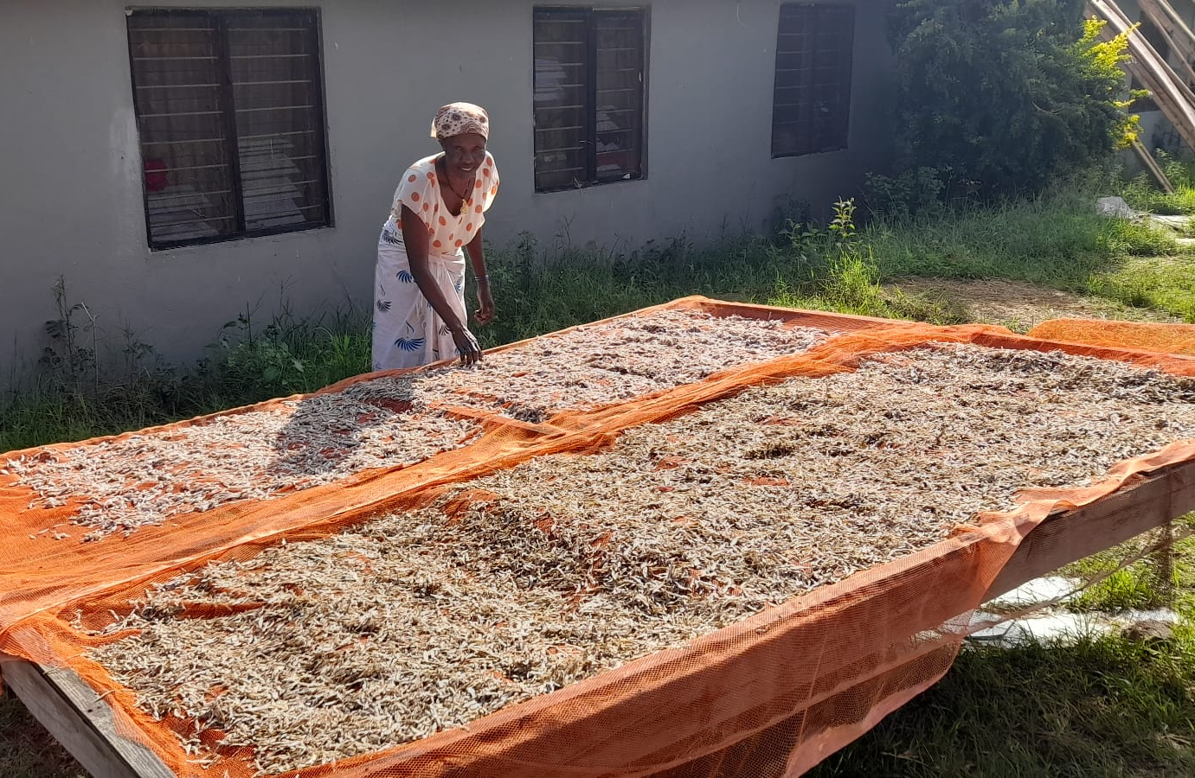
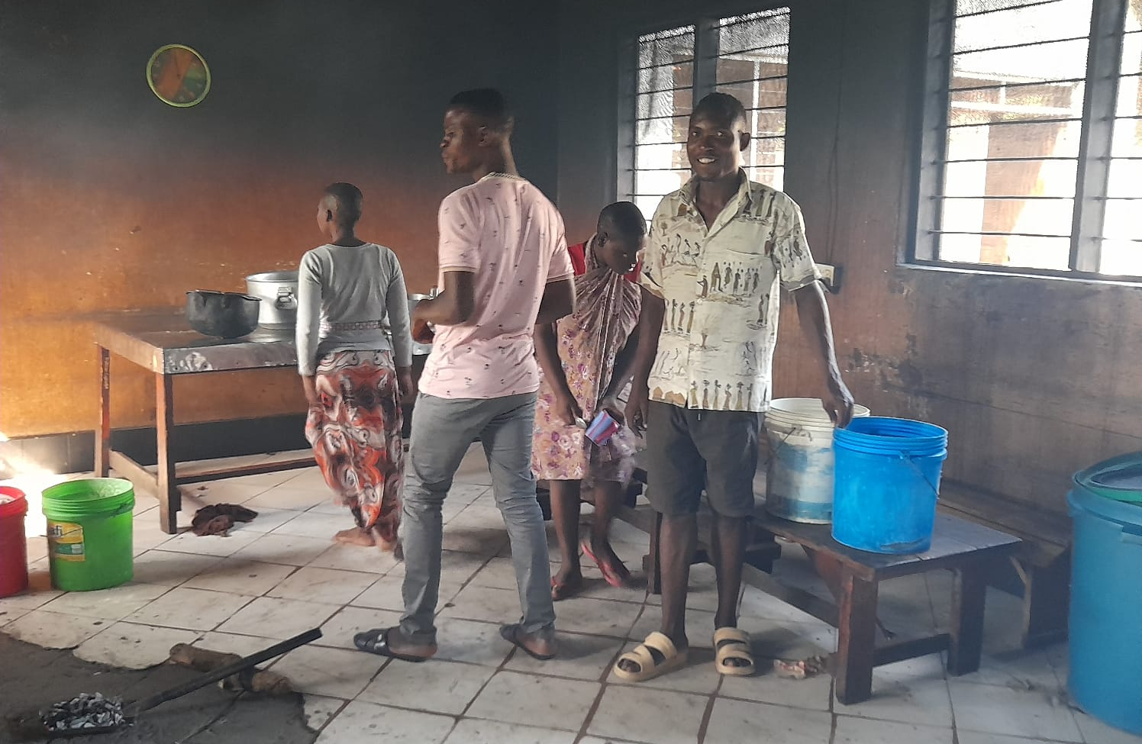
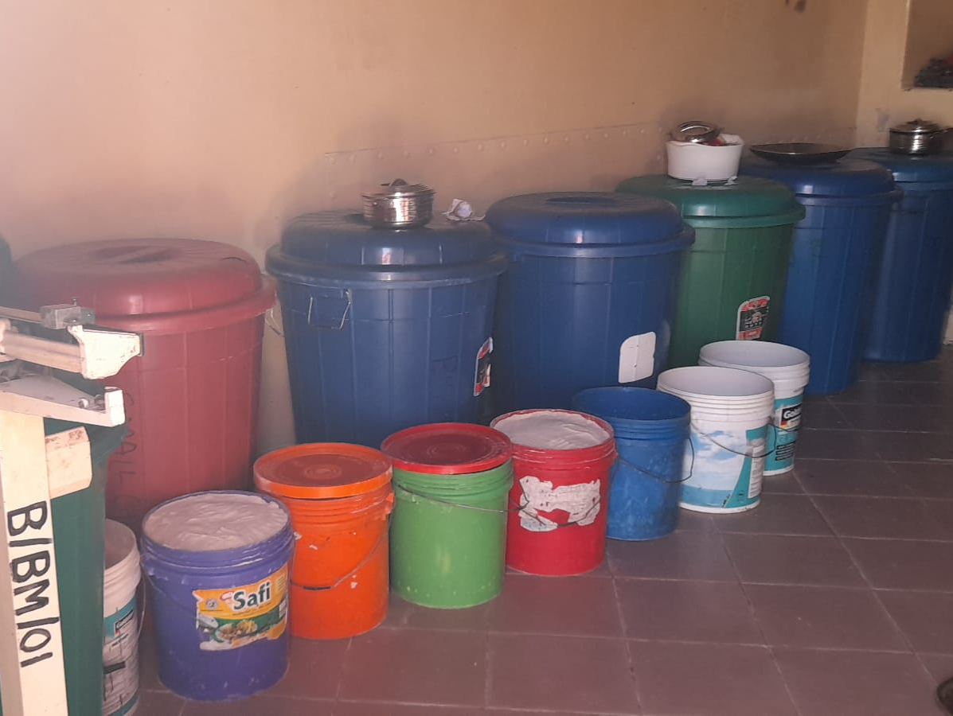
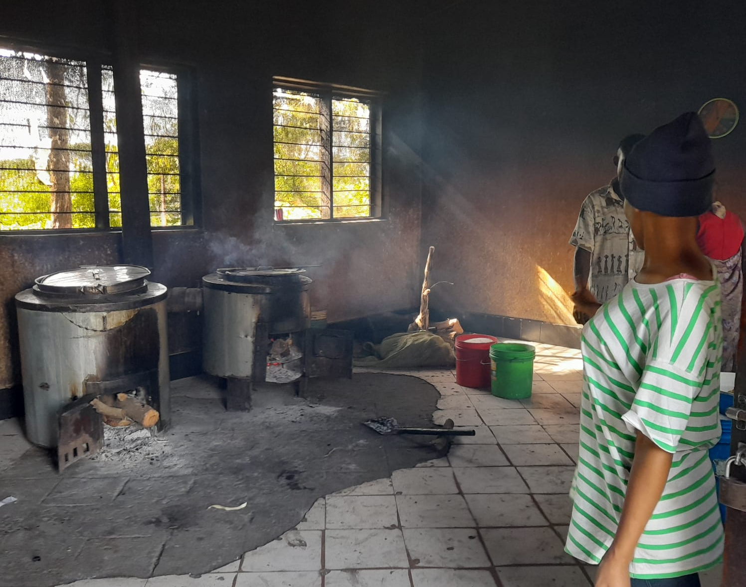
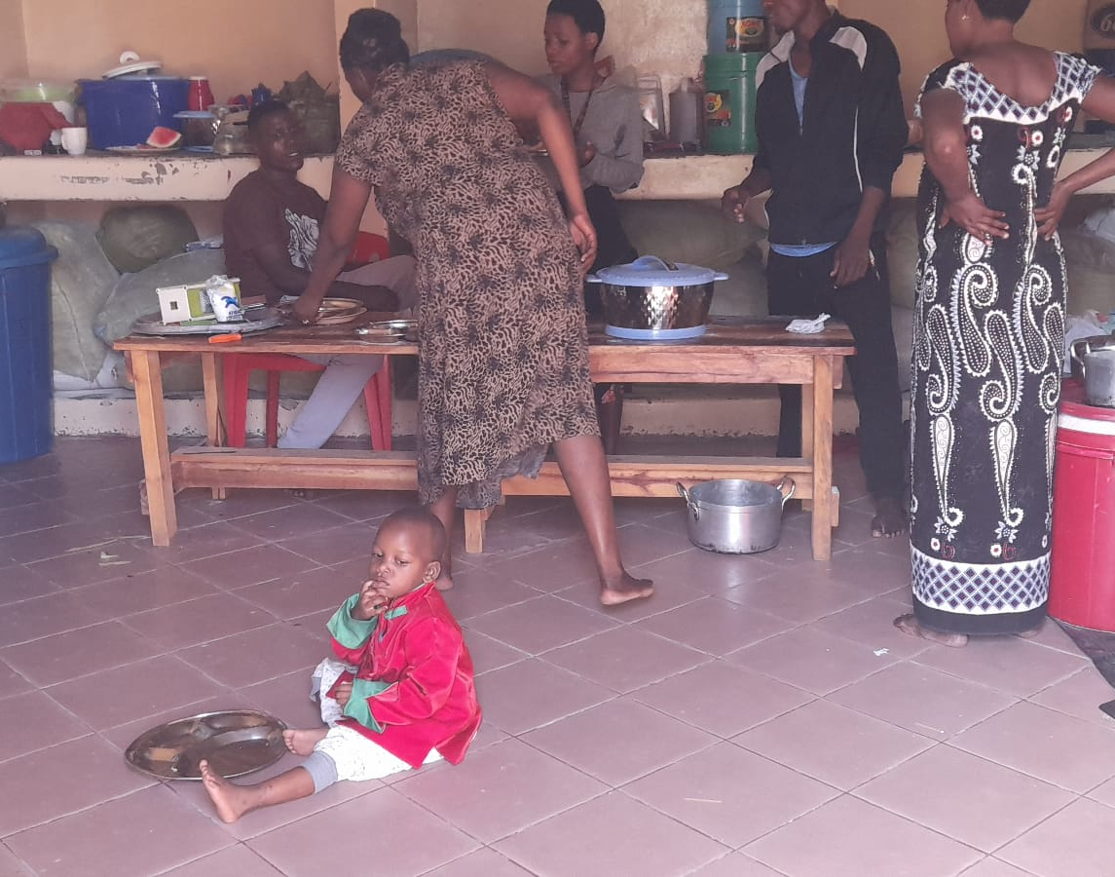
Notes:
Kitchen (building) and food prep areas (in shipping containers).
Food storage (beans/rice/maize)
Little fish drying ready for storage.

Slide 12
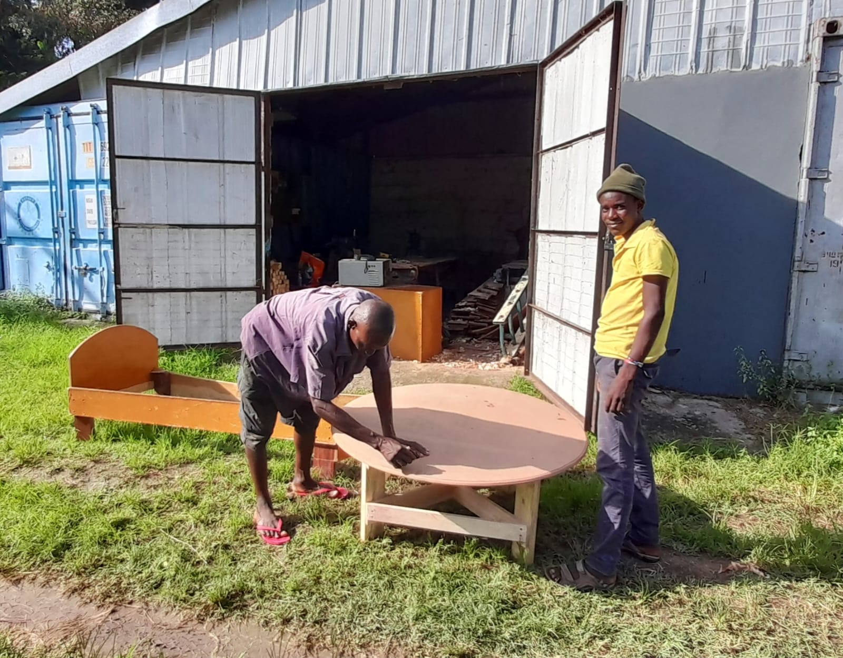
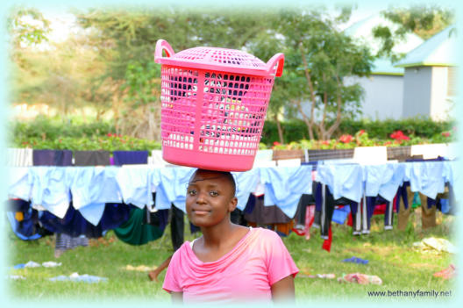
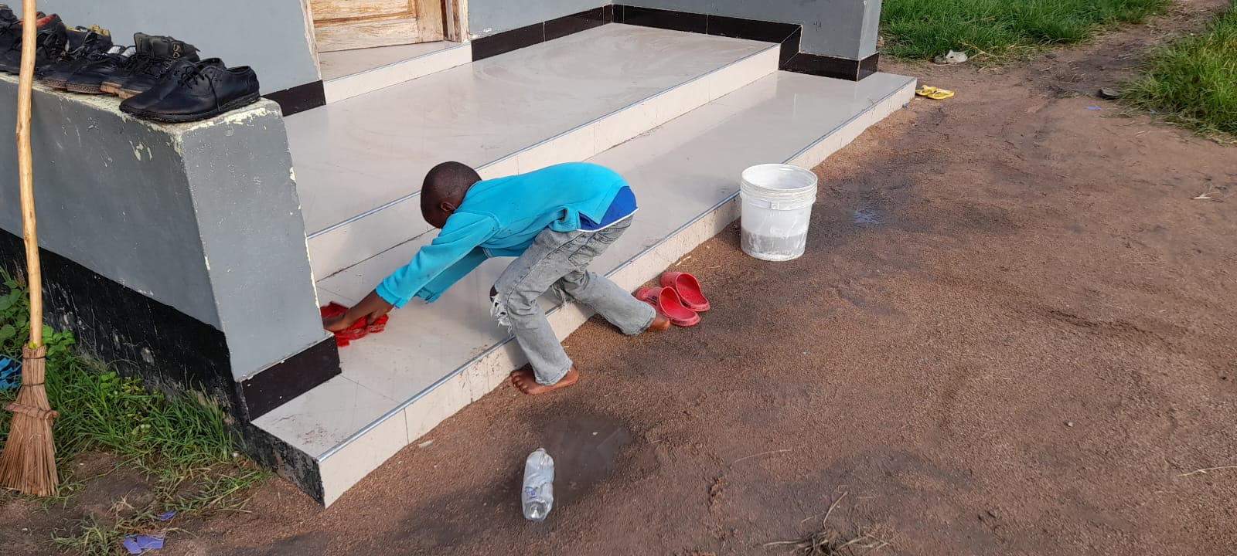
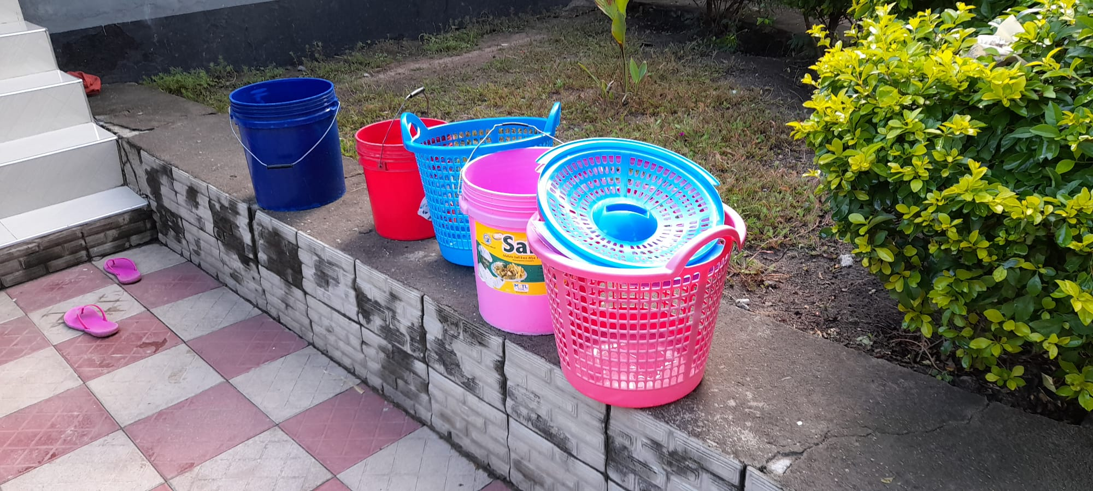
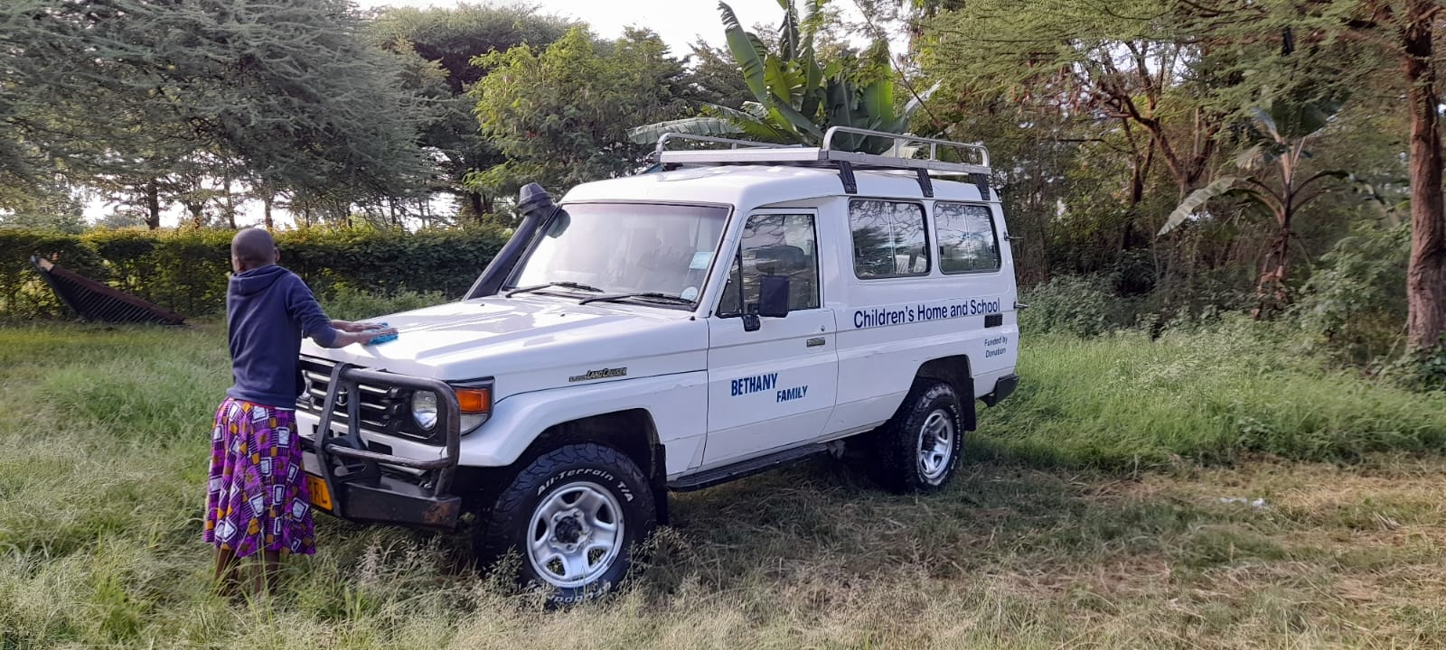
Notes:
Carpentry and joinery workshop – where they repair and build what’s required.
Kaboola demonstrating her balancing skills with washing behind and plenty of it.
Morning chores for the boys.
Sogesca’s corm mill for milling maize into flour – a staple part of their diet.
Washing buckets 9when showers not working) and laundry baskets for the bungalow.
Girls’ turn for cleaning the Bethany Landcruiser (there are 2) . Used by Bethany and to support villagers in need of hospital/medical treatment (no ambulances here).

Slide 13
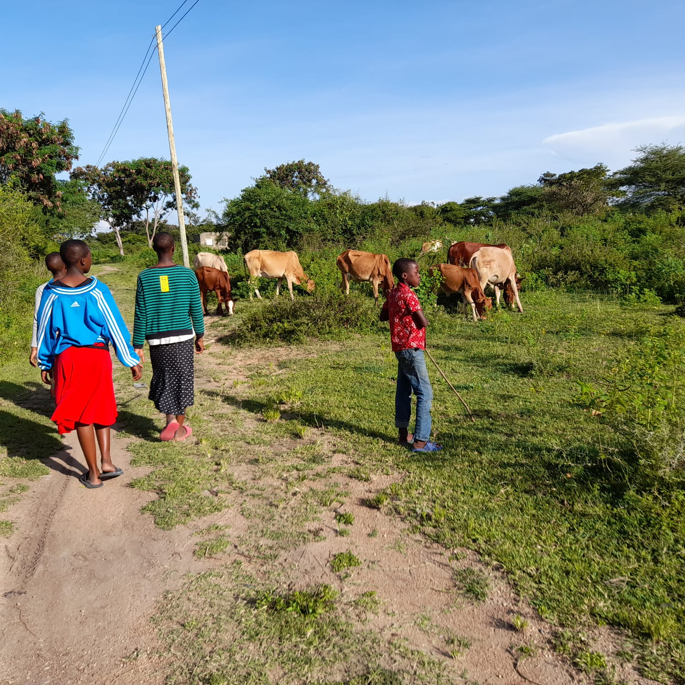
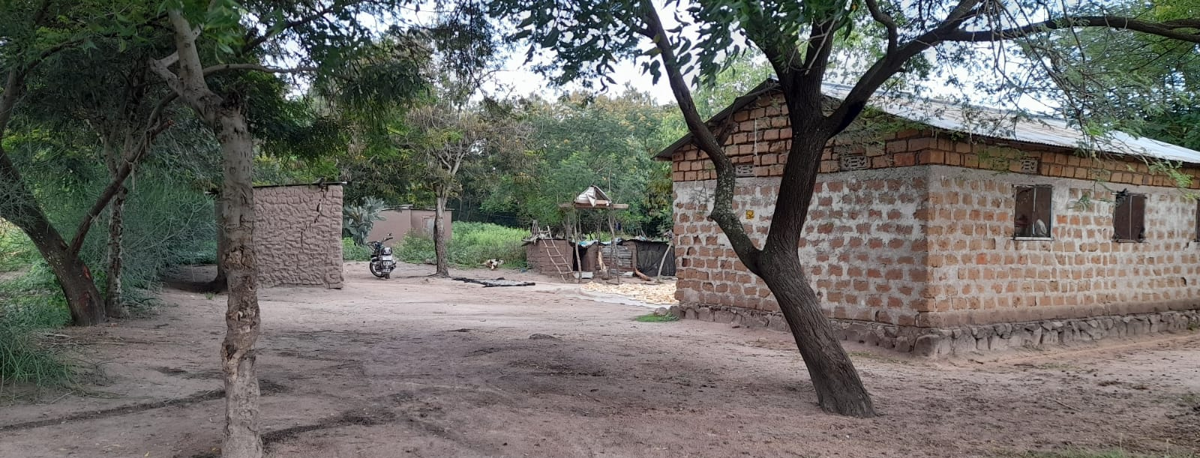
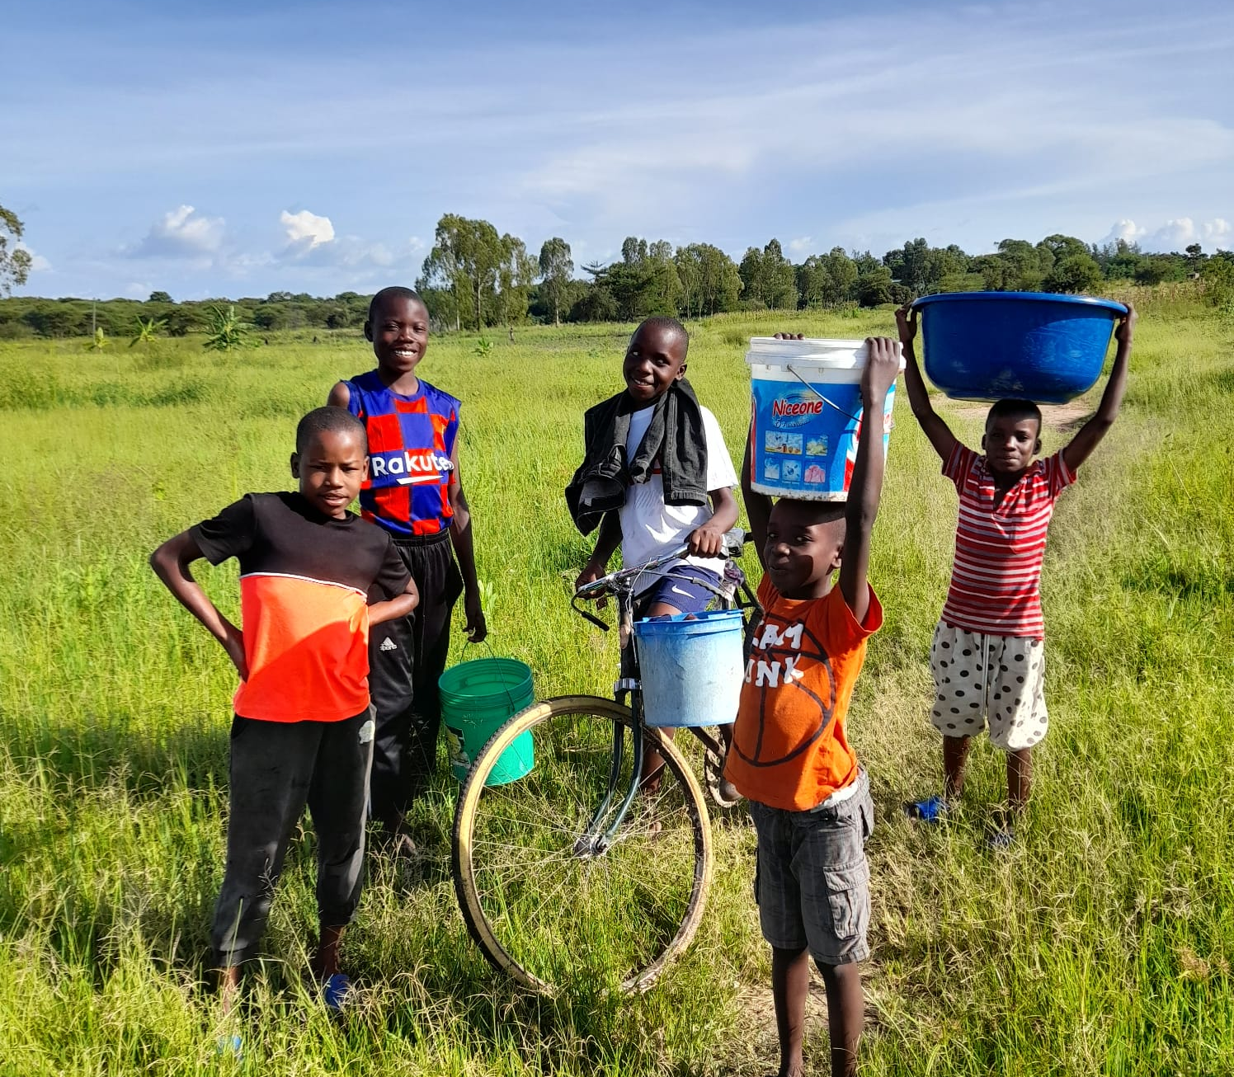
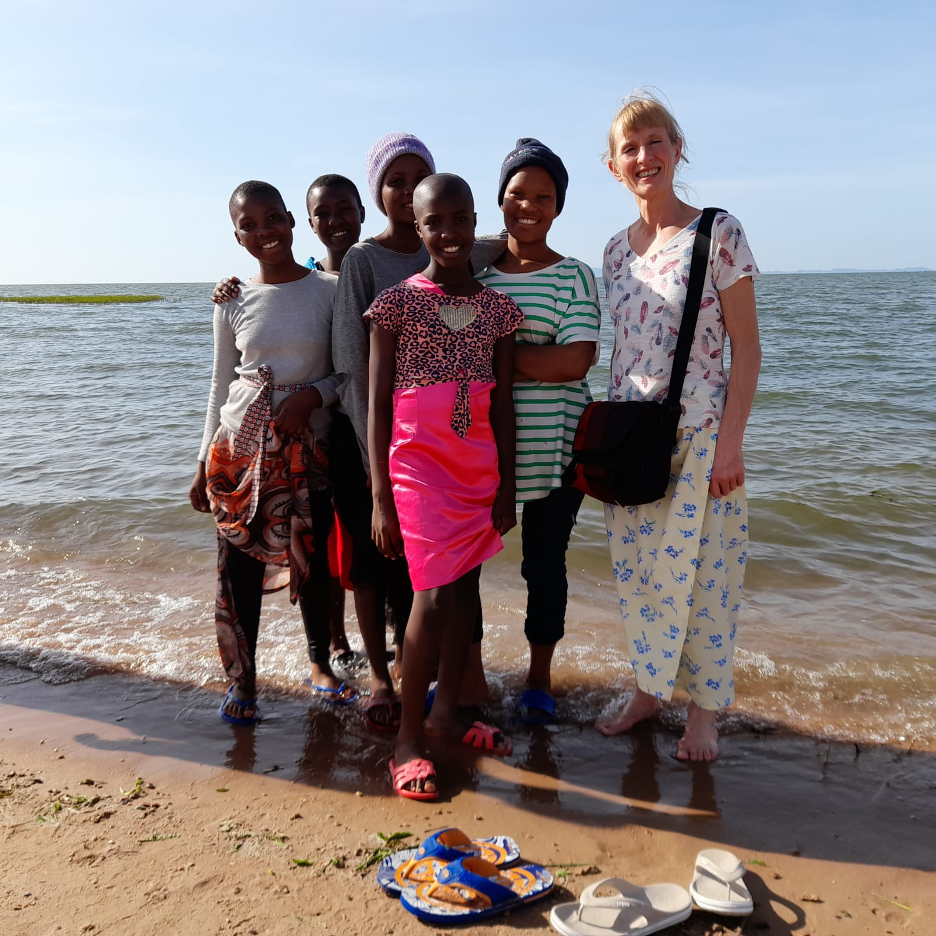
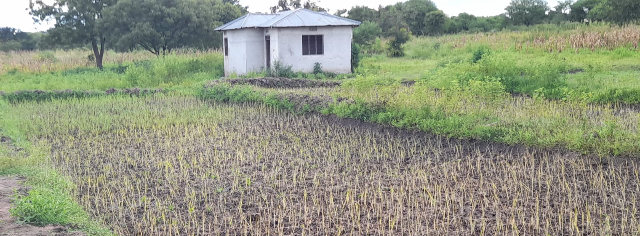
Notes:
Scenes from around Bethany.
No swimming – crocs and hippos and bugs.
Local lads from the village collecting water from lake Victoria
Rice paddy fields.

Slide 14
Notes:
BK
Fisherman scaring little fish out of hiding into his nets
A demonstration of years of practice balancing…. The smallest slip could be fatal..(crocodiles)

Slide 15
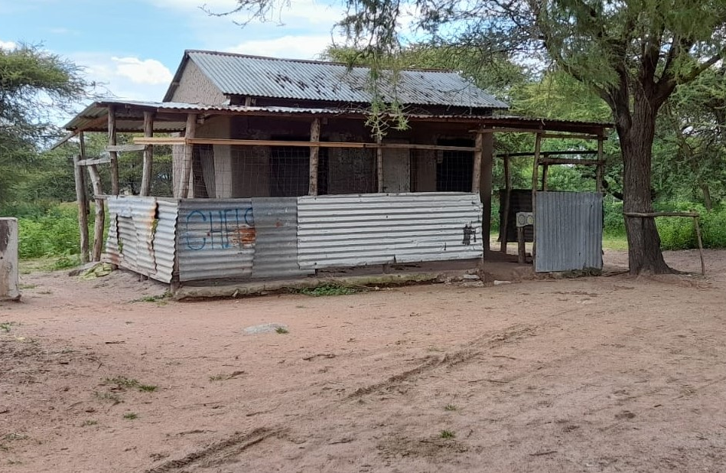
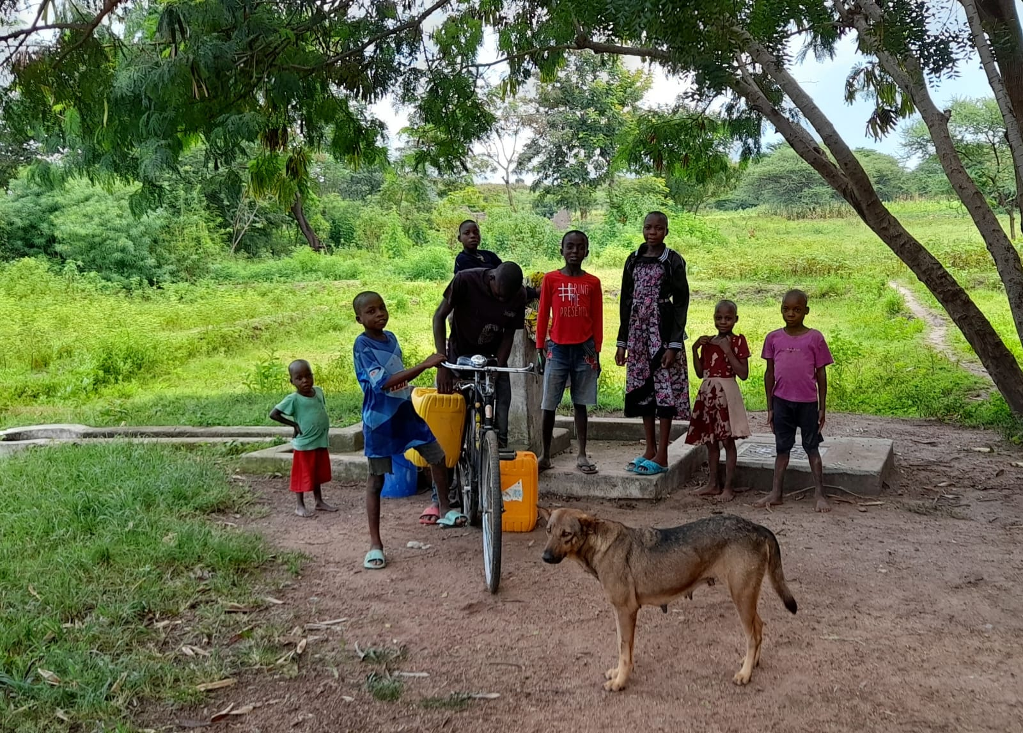
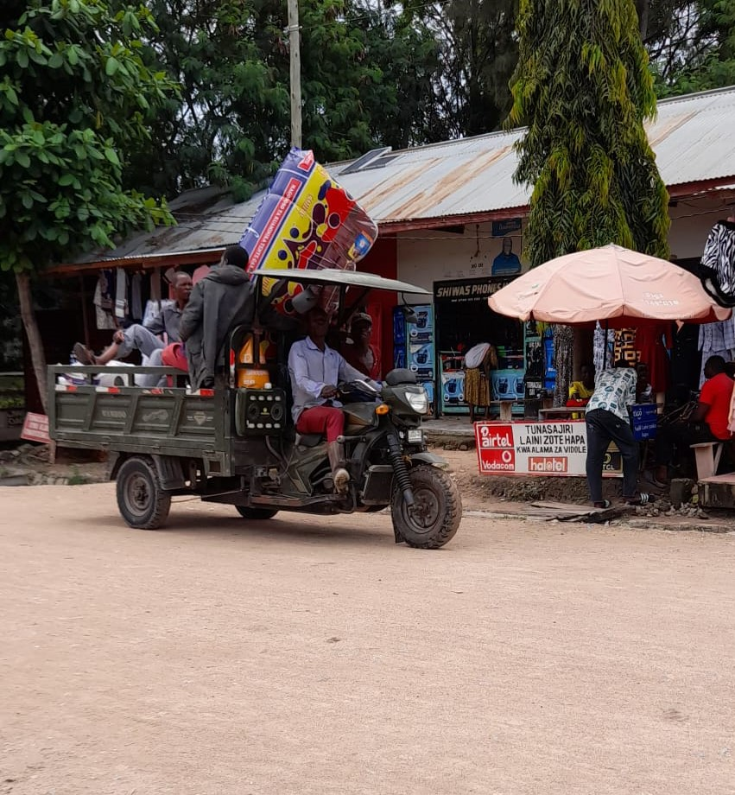
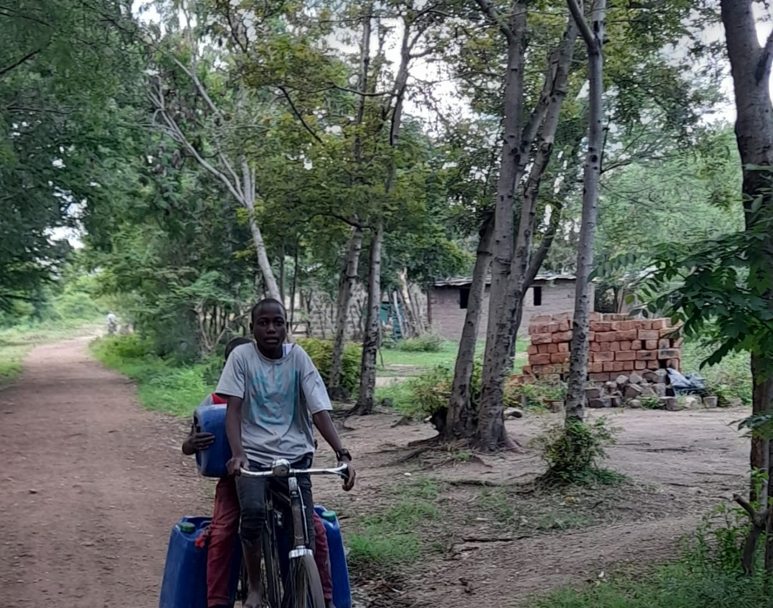
Government clean water collection point
Local café and restaurant
Amazon Prime Tanzanian style!
(next day delivery? Hmm)
Transporting water home (everyday)
Multi-tasking
Notes:
Local scenes:

Slide 16
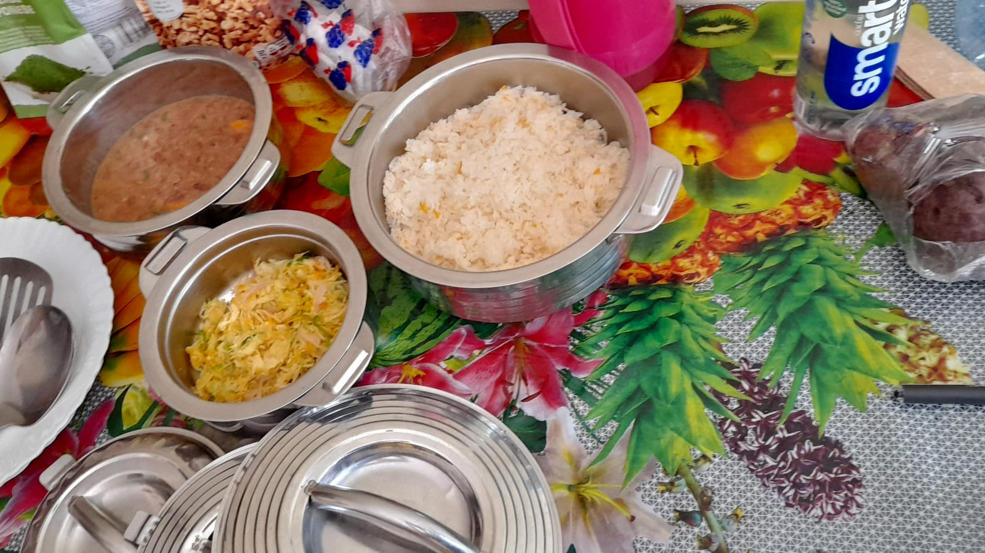
Notes:
Grace was an amazing chef/cook and grew up at the orphanage.

Slide 17
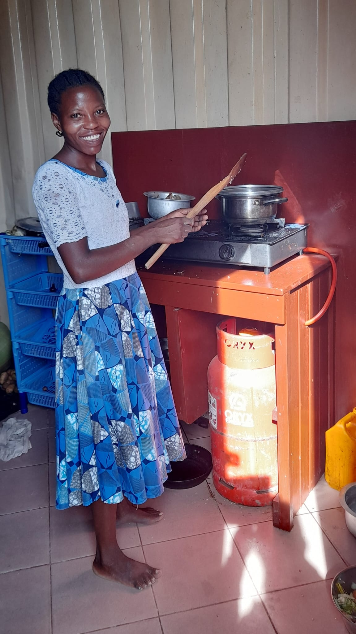
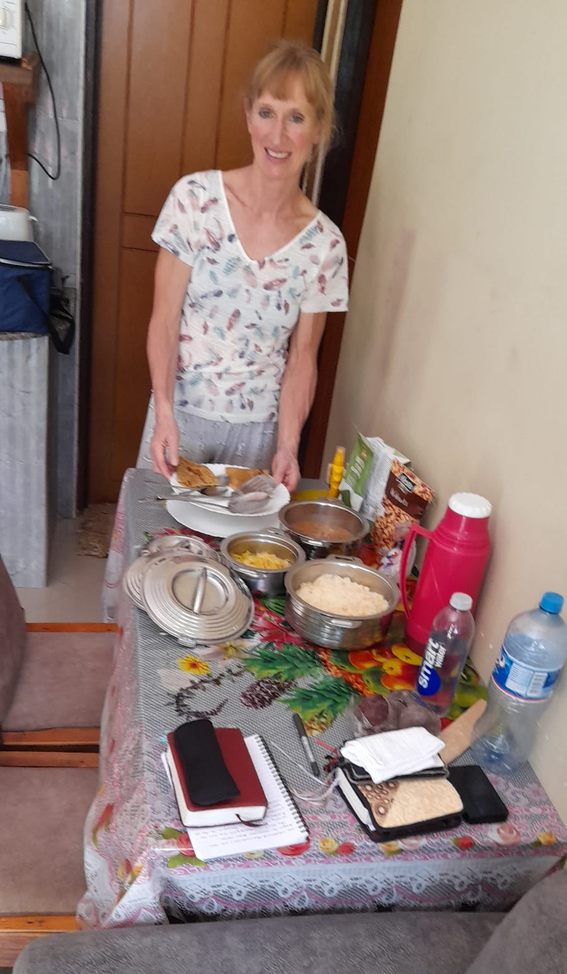
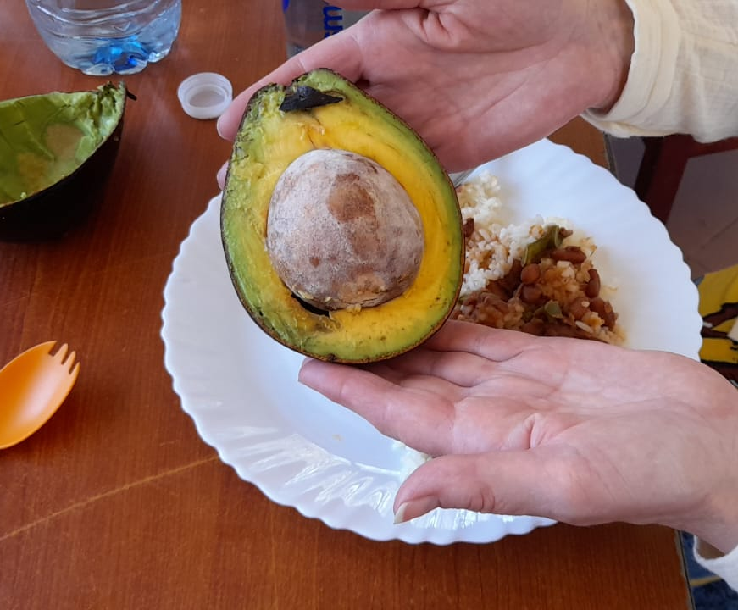
Notes:
Grace made us some amazing food
We tried all the local staple food except the fish.

Slide 18
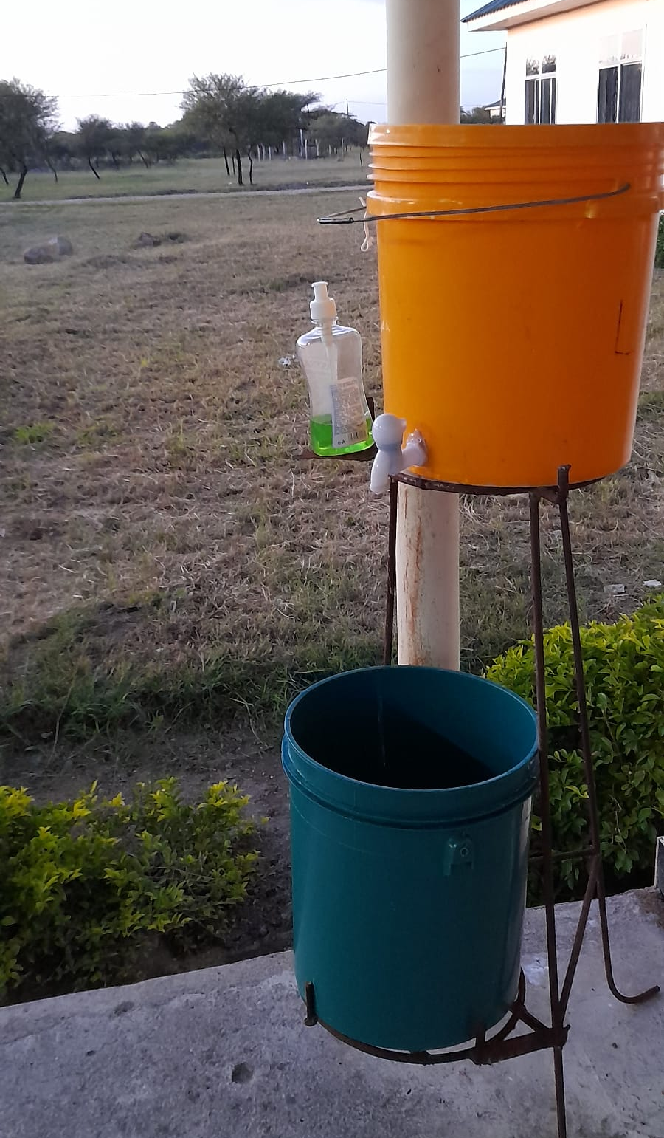
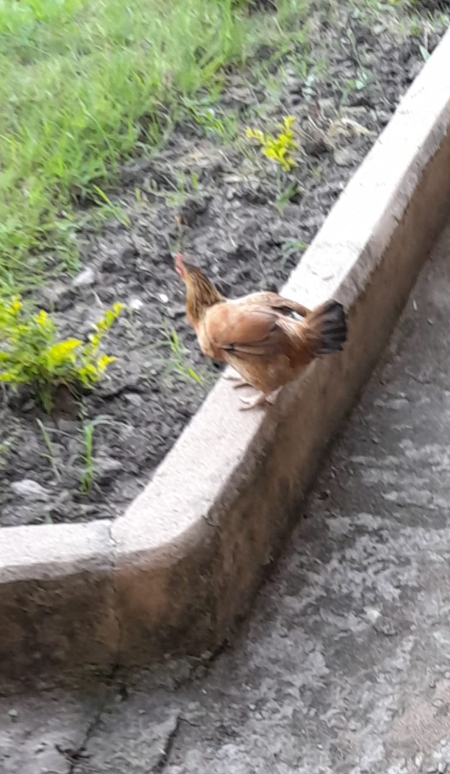
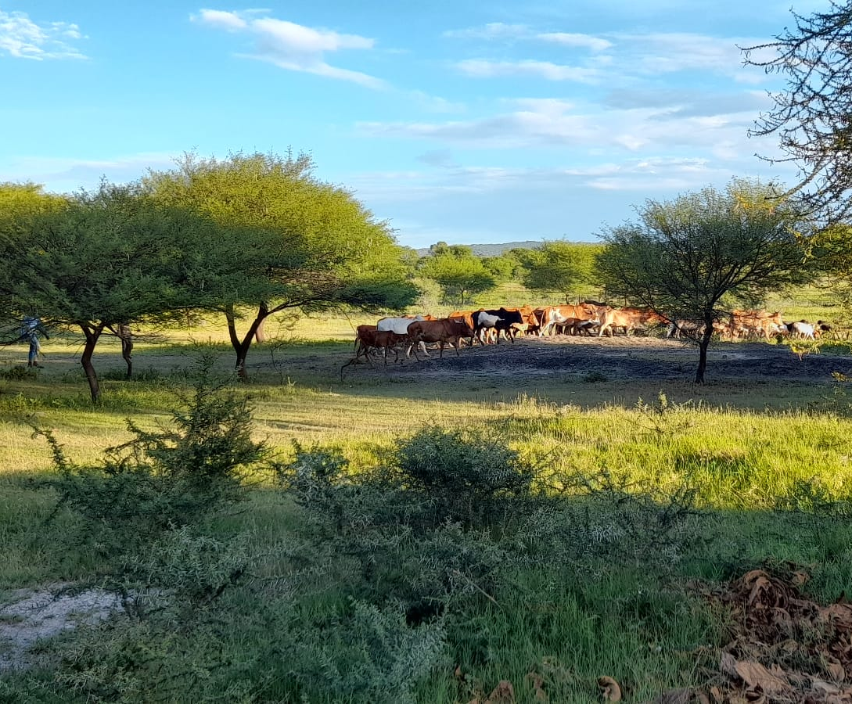
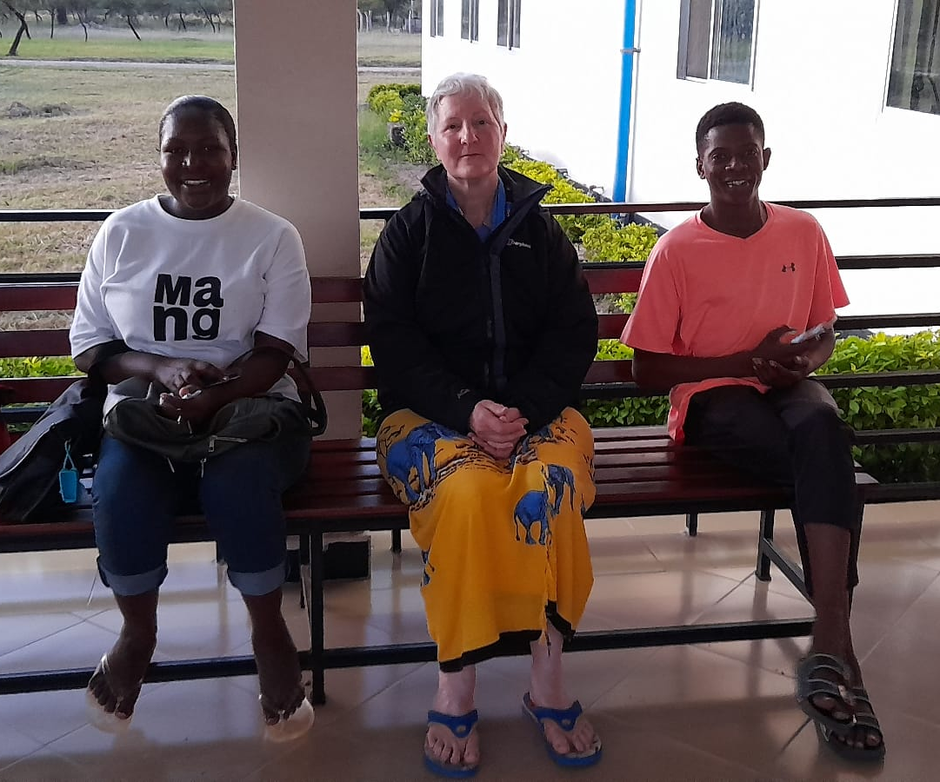
Notes:
BK
Trip to the hospital
Praying before anything was a normal part of life.
Waiting area
Sick chicken
Family affair – Mgosi is going to college this summer to become an electrician.

Slide 19
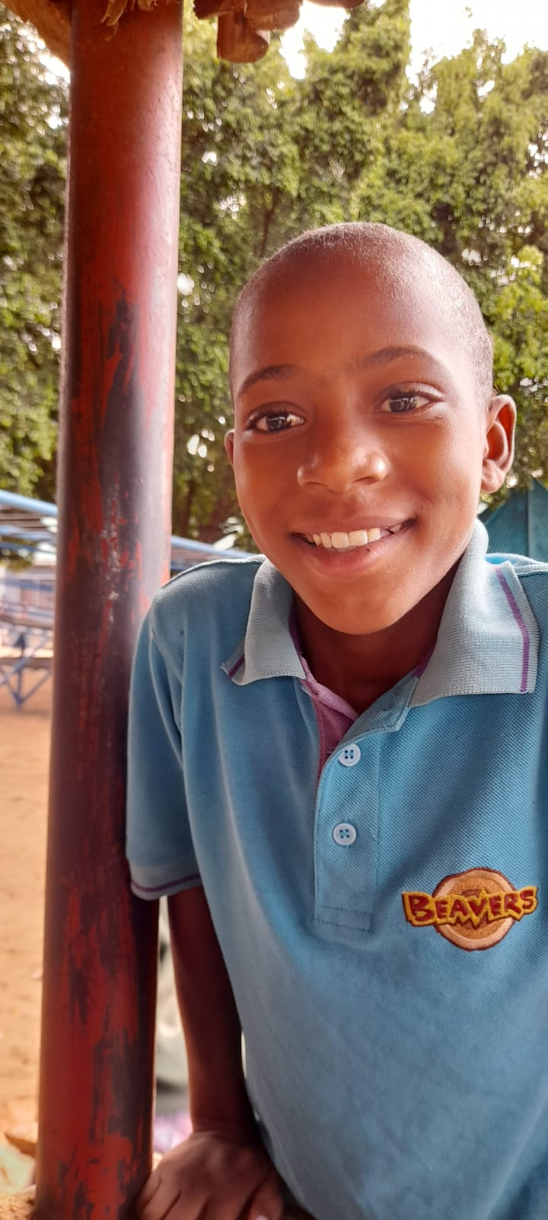
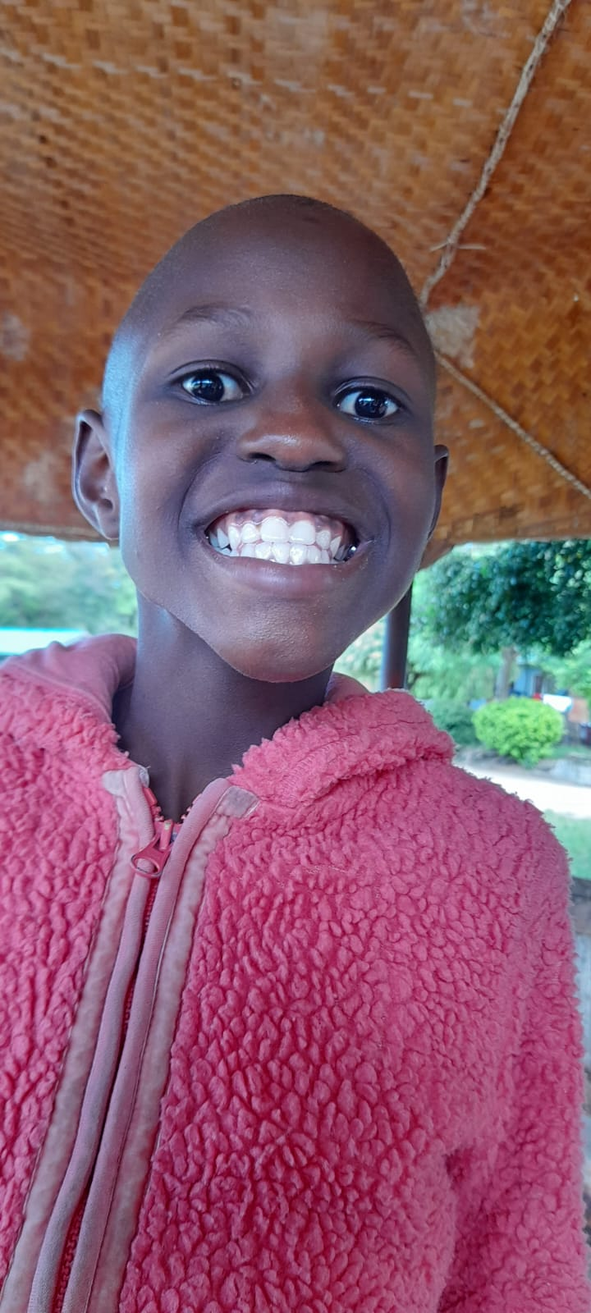
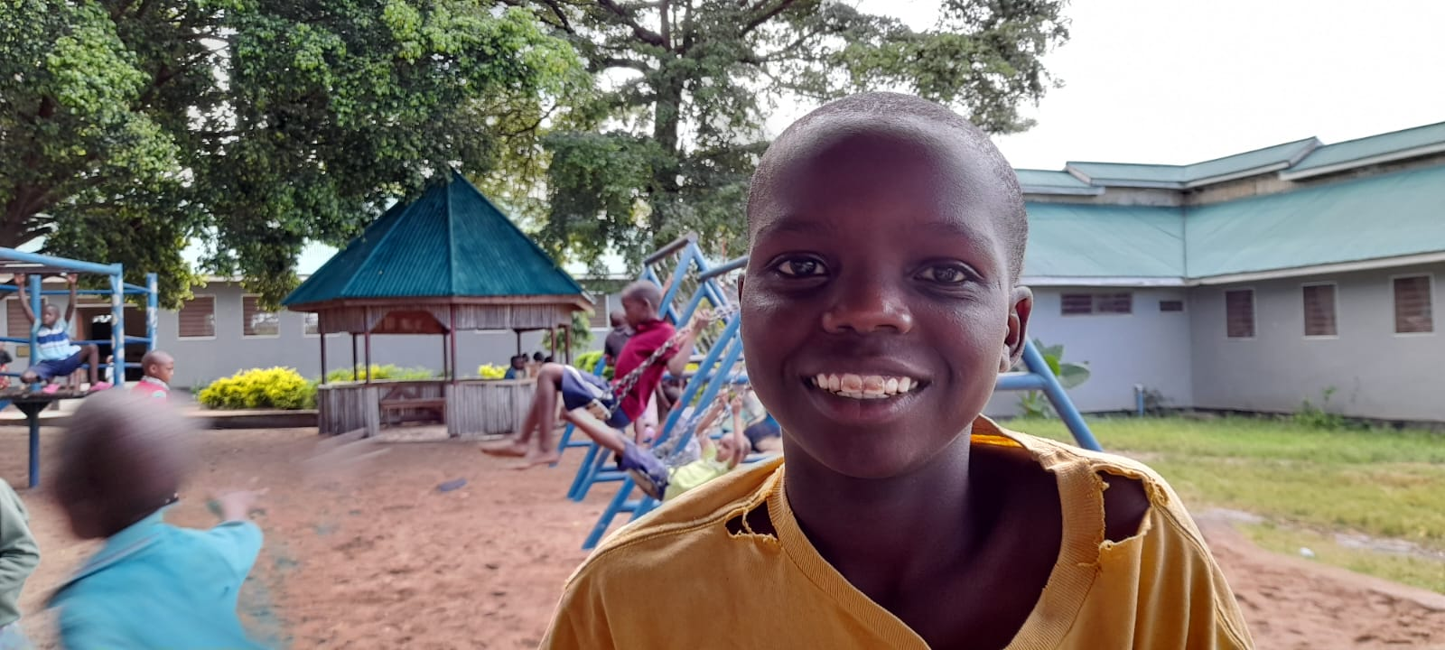
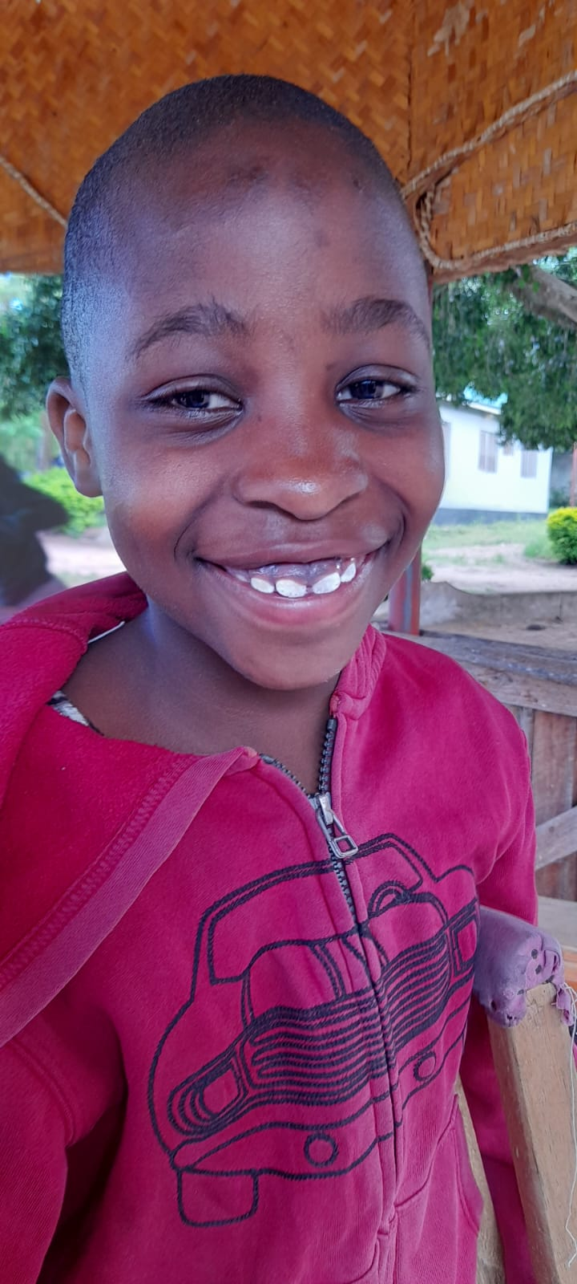
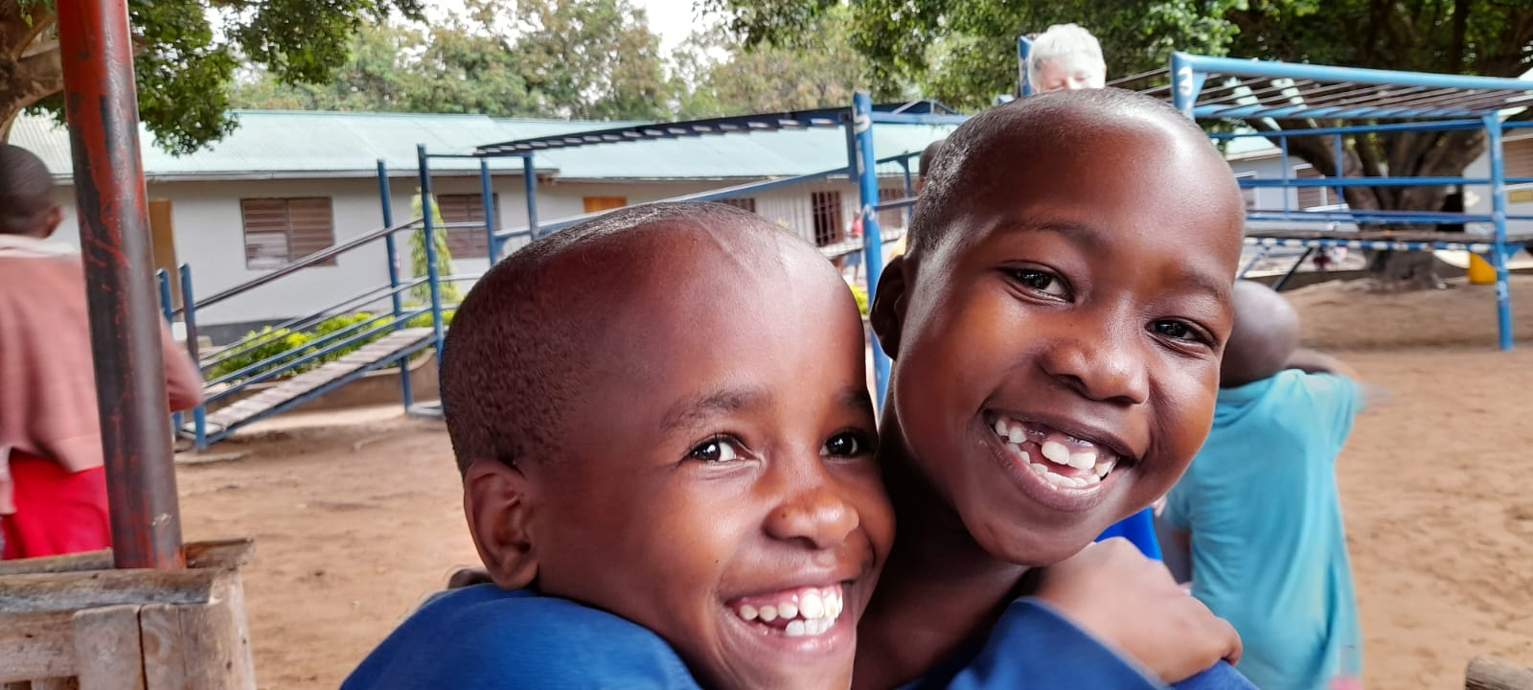
B
E
T
H
A
N
Y
K
I
D
S
Notes:
What do you notice about these children? And it’s not just for the camera.
Smiling
Contented, joyful.

Slide 20
Bethany Staff
Notes:
Morning prayers.
Jesca (Coordinator) and former child of Bethany, and husband.
Grace – the amazing cook/chef.
Security guard/emergency seamstress.

Slide 21
Bethany Primary School Staffroom
Notes:
School teachers employed by the government.
Morning breakfast of maize porridge provided by Bethany.
The normal teachers’ workload.
Emma – headmistress and former child of Bethany and the first child to go there. Through Bethany Project completed a degree in teaching in the UK funded by donations.
A few minutes available to read the bible before classes start.

Slide 22
Christmas Day at Bethany
Notes:
BK
Christmas Day at Bethany. Usually, the children have a special celebration with lots of coloured rice, meat and soda. However, this year Jesca talked to the children about using the money for the celebration to give basic items like mattresses to sleep on to the more deprived in the village and so this is what they did.

Slide 23
Dishwasher
Harvesting maize
Babysitting
Morning prayers
Hairdressing – one size fits all.
I need a wee!
Notes:
BK
Daily life at Bethany.
Morning prayers: singing, a message from the word and prayers for the day ahead. They prayed before doing anything.

Slide 24
Dotto
Veronica
Ravin
Mditi
Mgosi
Penzen
Notes:
LK
Some of the children and young people.
Mditi has Sickle Cell Anaemia (untreatable in Tanzania).
Veronica lost her leg below the knee following a road accident.
Penzen is a Scout; one of the Scouts’ jobs is to ring the school bell.

Slide 25
Notes:
LK & BK
Classroom life – including mopping between lessons.
Secondary kids call in to see us daily on the way back from school.

Slide 26
Notes:
BK
The younger children had a lovely way of rewarding each other for getting something right.

Slide 27
Sports afternoon:
1^{st, 2nd and 3rd prizes}
= 1 teaspoon of glucose powder.
Notes:
The novelty of a white face didn’t seem to wear off!
The winners often shared their prize with the other children.

Slide 28
Mr Daniel’s home
Mr Daniel is head of Year 6 at Bethany
Notes:
LK
Unglazed windows (perfect for children poking their heads in)
Mr D’s fiancée.
Buckets and cannister to collect water from the standpipe – a ten-minute walk with a wheelbarrow.
Water decanted into a storage bin.
Sweet spaghetti and fruit and bottled water for the guests.

Slide 29
Notes:
LK
Local children fascinated to see who he had in his home. They became braver as time went on.

Slide 30
A dog’s perspective
Notes:
BK
Don’t come this way – danger
Mid-morning siesta at school
Morning sleep after a hard night’s work keeping guard
Dog escort x 3

Slide 31
Notes:
BK
HOW BETHANY KIDS AMUSE THEMSELVES
FOOTBALL – made from tied up plastic bags
PLAITING MY HAIR
PLASTIC ROPE made from bottle tops, chewed to soften them.
SUBUTIO using bottle tops
SWINGS
SINGING
PRAYERS IN THE EVENING

Slide 32
Notes:
LK
VISIT TO THE MARKET in Magu.

Slide 33
Notes:
LK
Girls were our bodyguards – it was like being famous!
Neema/Teddy and Dotto.

Slide 34
Sogesca village
The village cinema
Notes:
LK
VISIT TO LOCAL VILLAGE SOGESCA
.

Slide 35
Proudly displaying their ‘Little people’
Off to school
Naming their creations
Concentration
Notes:
BK
CRAFT AFTERNOONS – DEBBIE’S GOOD IDEAS – CORN DOLLIES.

Slide 36
Church on Sunday
Little ones’ turn to sing
Bibles are a precious commodity
Heartfelt prayers
Notes:
LK
Sunday worship and evening prayers

Slide 37
Notes:
Walk in the Light

Slide 38
It is hard to stay still when praising the Lord …
even when not called to the front
Notes:
Some couldn’t praise without moving ☺

Slide 39
Notes:
LK
Neema, Anna, Mgosi, Kaboola and Teddy going to High School and College.

Slide 40
Daily evening prayers
Notes:
LK
Evening Prayers

Slide 41
Uneventful journey home
Finally saw a giraffe!
Guess which airport loo we used?
First opportunity to do some knitting!
27 hours
Notes:
BK
JOURNEY HOME – DEBBIE’S BIRTHDAY – UNEVENTFUL.

Slide 42
Farewell Cards and Letter
Notes:
LK

Slide 43
Teaching Staff
Further education
Running costs
Bethany needs support with ….
Clothes
University fees
Orphanage
staff
Medical expenses
Transport
Food
Schooling
Books
College
fees
Notes:
Bethany is almost entirely funded by donations
Education is the key to lifting children out of poverty and the stigma of being an orphan.
Bethany school is free to all who attend 140 children from Bethany, 200 from surrounding villages.

Slide 44
Keep in touch
Host a presentation event
Social media
How can we help?
Fund raising
Financial support
Visit Bethany
Prayer
Notes:
Donorsee – one off donations (eg for toothbrushes/tracksuits/mosquito nets).
Regular giving via standing order.
Coffee mornings
Sponsored events
Sponsor children for further education
You Tube: Unapendo/Facebook: The Bethany Project
If you want to visit, contact Graham Pountain (founder)

